Slide 1
Benefits and Applications of Large Language Models (LLMs)
Pierre Lison
Norsk Regnesentral (NR)
plison@nr.no
CuttingEdgeAI on Large Language Models
February 21, 2023, Oslo

Slide 2
Transfer learning
Large Language models are representation learners
Although they are trained on the task of word prediction, they can be fine-tuned to perform many other tasks
The linguistic knowledge stored in the initial model can be transferred onto new tasks
Easier to learn models from small amounts of data
Better performance / robustness than models trained from “scratch”

Slide 3
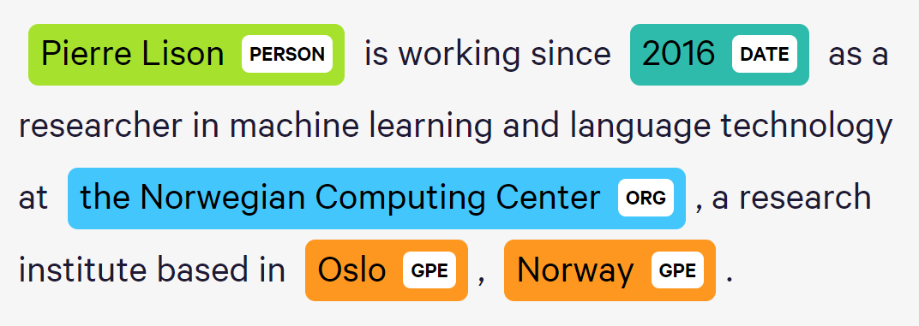
Document intelligence
Automated classification
Filtering
Sentiment analysis
Information extraction (entity recognition, relation extraction, etc.)
Text de-identification

Slide 4
Content creation
Autocomplete ++
Writing assistance (grammar checking, style suggestions, etc.)
«Co-pilot» for programmers
Text summarization

Slide 5
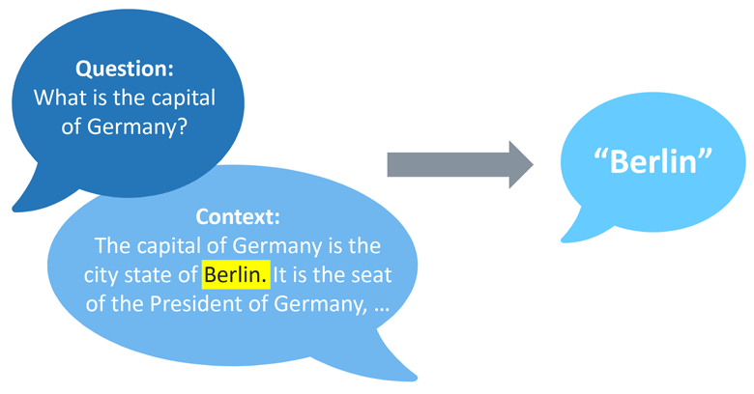
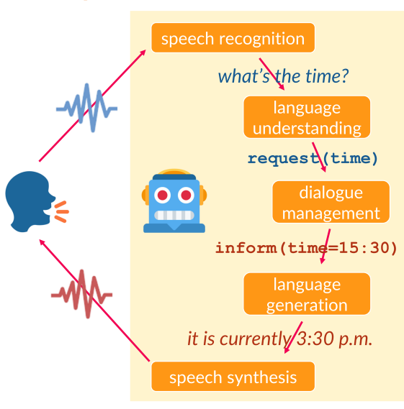
Interactive systems
Open-ended chatbots
Task-oriented dialogue systems
Voice-activated assistants
Question answering (with knowledge base)

Slide 6
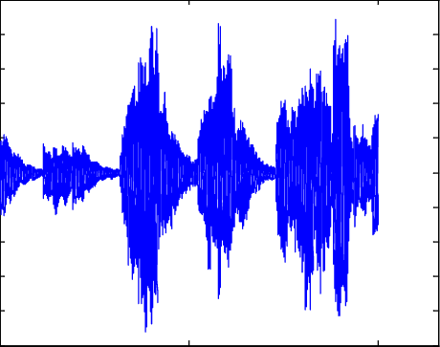
And many others!
Machine translation
Speech processing (e.g. speech recognition and synthesis)
Information retrieval (search)

Slide 7
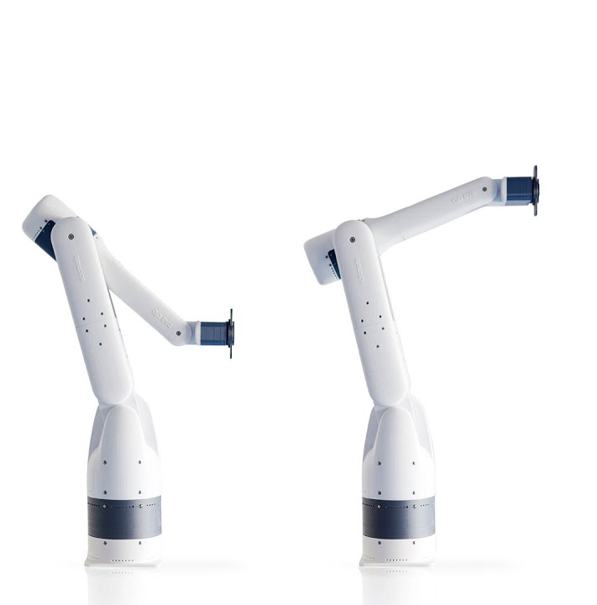
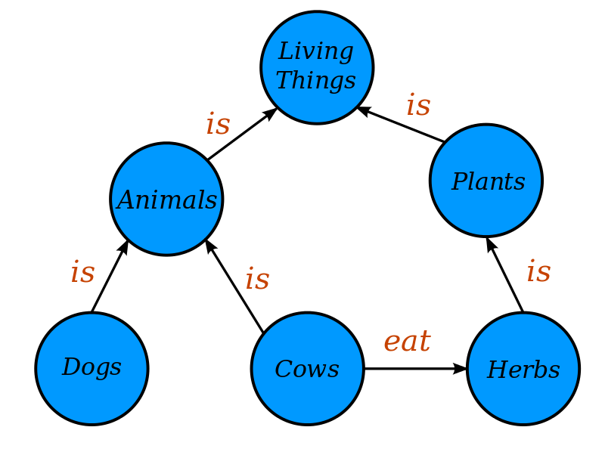
Next developments
Multimodal models
LLMs trained along with non-text data
Images, videos, sensorimotor experience, etc.
Knowledge-augmented models

