Slide 1
Large Language Models and their use in research
Pierre Lison
Norsk Regnesentral (NR) & UiO
plison@nr.no
TIK9015 – STS Methodologies: Practice-Oriented Document Analysis
November 9, 2023, Oslo

Slide 2
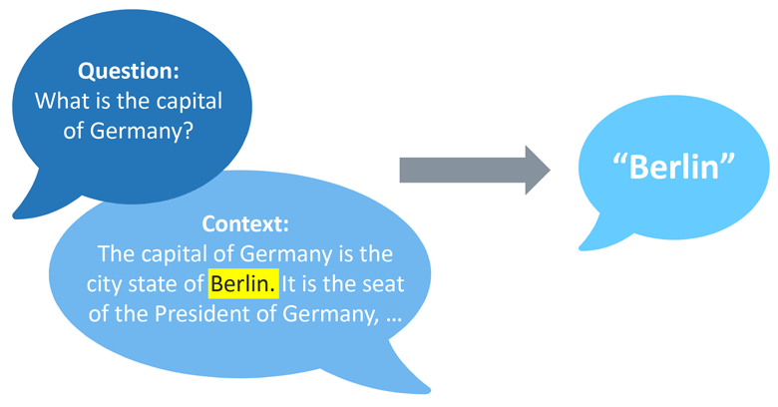
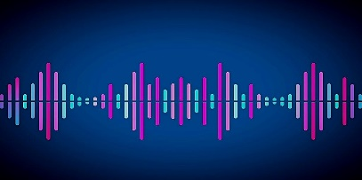
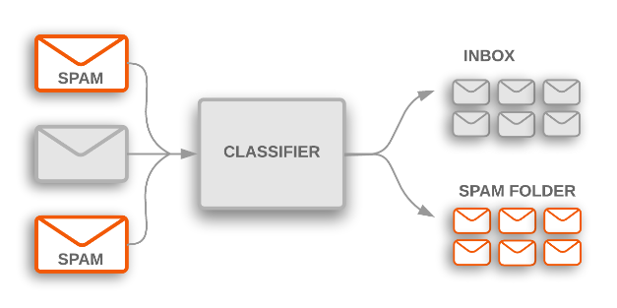
Language technology
“Text mining” (retrieving and extracting information from large amounts of texts)
Machine translation
Dialogue systems (chatbots etc.)
Writing support (spellcheck, autocomplete, etc.)
Speech technology
Text classification

Slide 3
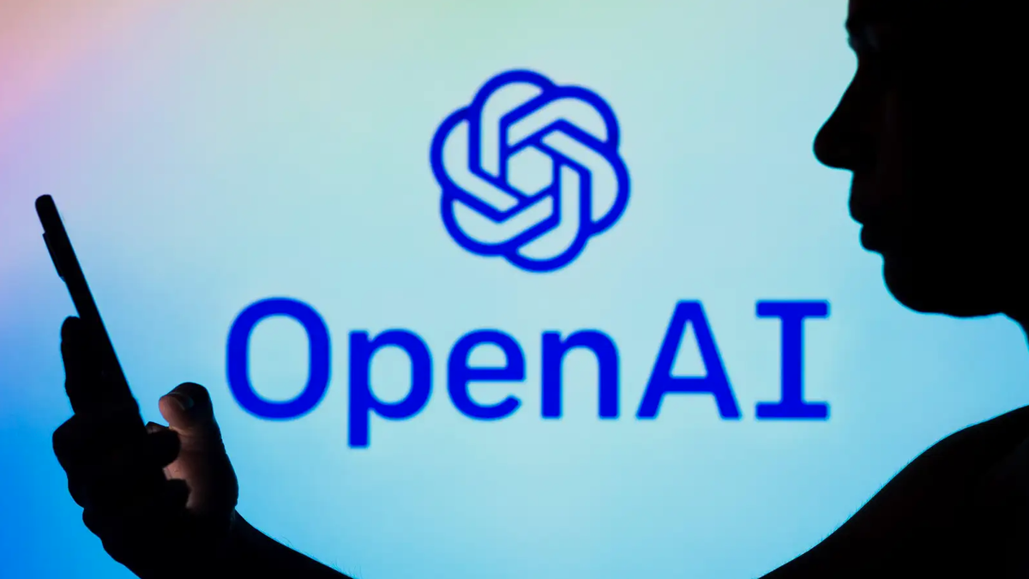
The advent of Large Language Models (LLMs)

Slide 4
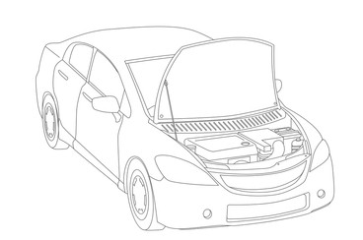
The advent of Large Language Models (LLMs)
Today's language technology software almost always have a large language model at their core
But a complete system is about much more than just a language model!

Slide 5
Outline
What are Large Language Models?
What can they be used for (esp. for researchers) ?
Challenges & new developments

Slide 6
Outline
What are Large Language Models?
What can they be used for (esp. for researchers) ?
Challenges & new developments

Slide 7
Large Language Models?
= Machine learning systems optimized to predict the next word in text
Deep neural network
(Transformer architecture)
with many billions of parameters
Trained on huge collections of texts crawled from the web (Wikipedia, books, web fora, etc.)
As a by-product of this “guessing game”, the neural model will gradually build up representations of both linguistic and world knowledge
This model can then be adapted for various text processing tasks

Slide 8
How does an LLM work?
And the result is used to predict something (often the next word)
[-3.4, 2.1, 3.7,…]
[3.6, 8.3, -2.1,…]
[2.4, -3.9, -4.6,…]
[3.8, -2.9, -2.8,…]
[-2.7, -3.1, 7.4,…]
[-8.1, -4.7, 5.2,…]
[1.1, -3.7, 3.3,…]
The vectors go through many processing layers
(so-called transformers)
[-2.1, 3.4, 6.2,…]
[3.6, 2.7, -1.2,…]
[-0.5, 2.2, -1.9,…]
[-7.9, -4.5, -1.3,…]
[2.3, -3.6, 3.1,…]
[-9.1, -9.3, 1.7,…]
[-7.2, 2.8, 8.1,…]
Each token is mapped to a vector (number sequence)
Her er en kort eksempel -setning .
Tokenization (= segmentation in word pieces)
“Her er en kort eksempelsetning.”

Slide 9
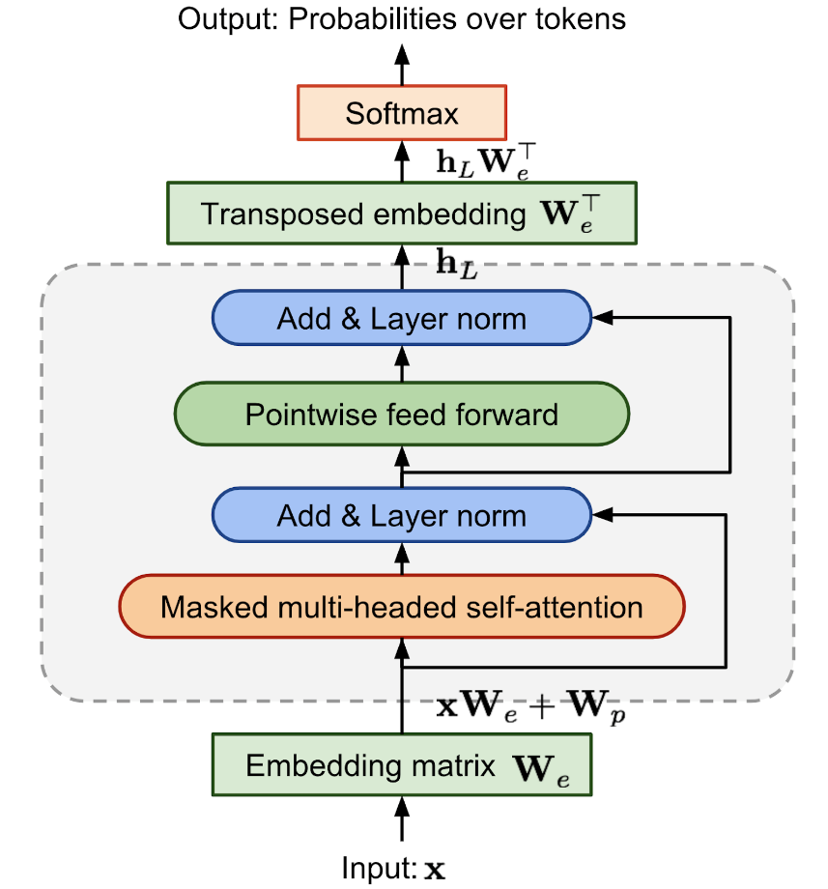
Transformers
Today’s language models are all variants of the same architecture: the transformer
Many processing layers on top of each other, each with their own parameters
Key idea: let the vector of each token be influenced by its context (=the tokens that precede/surround it)
How tokens “influence” each other’s vectors is something that is learned from data

Slide 10
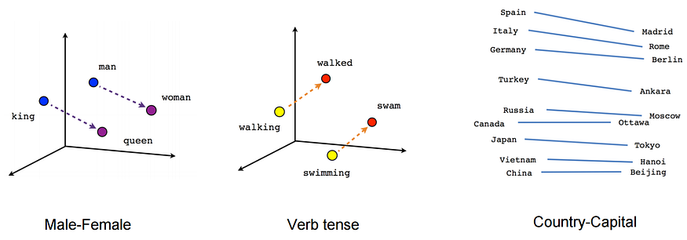
Token vectors
Hard to interpret high-dimensional numerical vectors!
But we can observe that those vectors do capture both linguistic features and generic background knowledge
Vectors derived from LLMs are contextualized: ≠ contexts → ≠ vectors

Slide 11
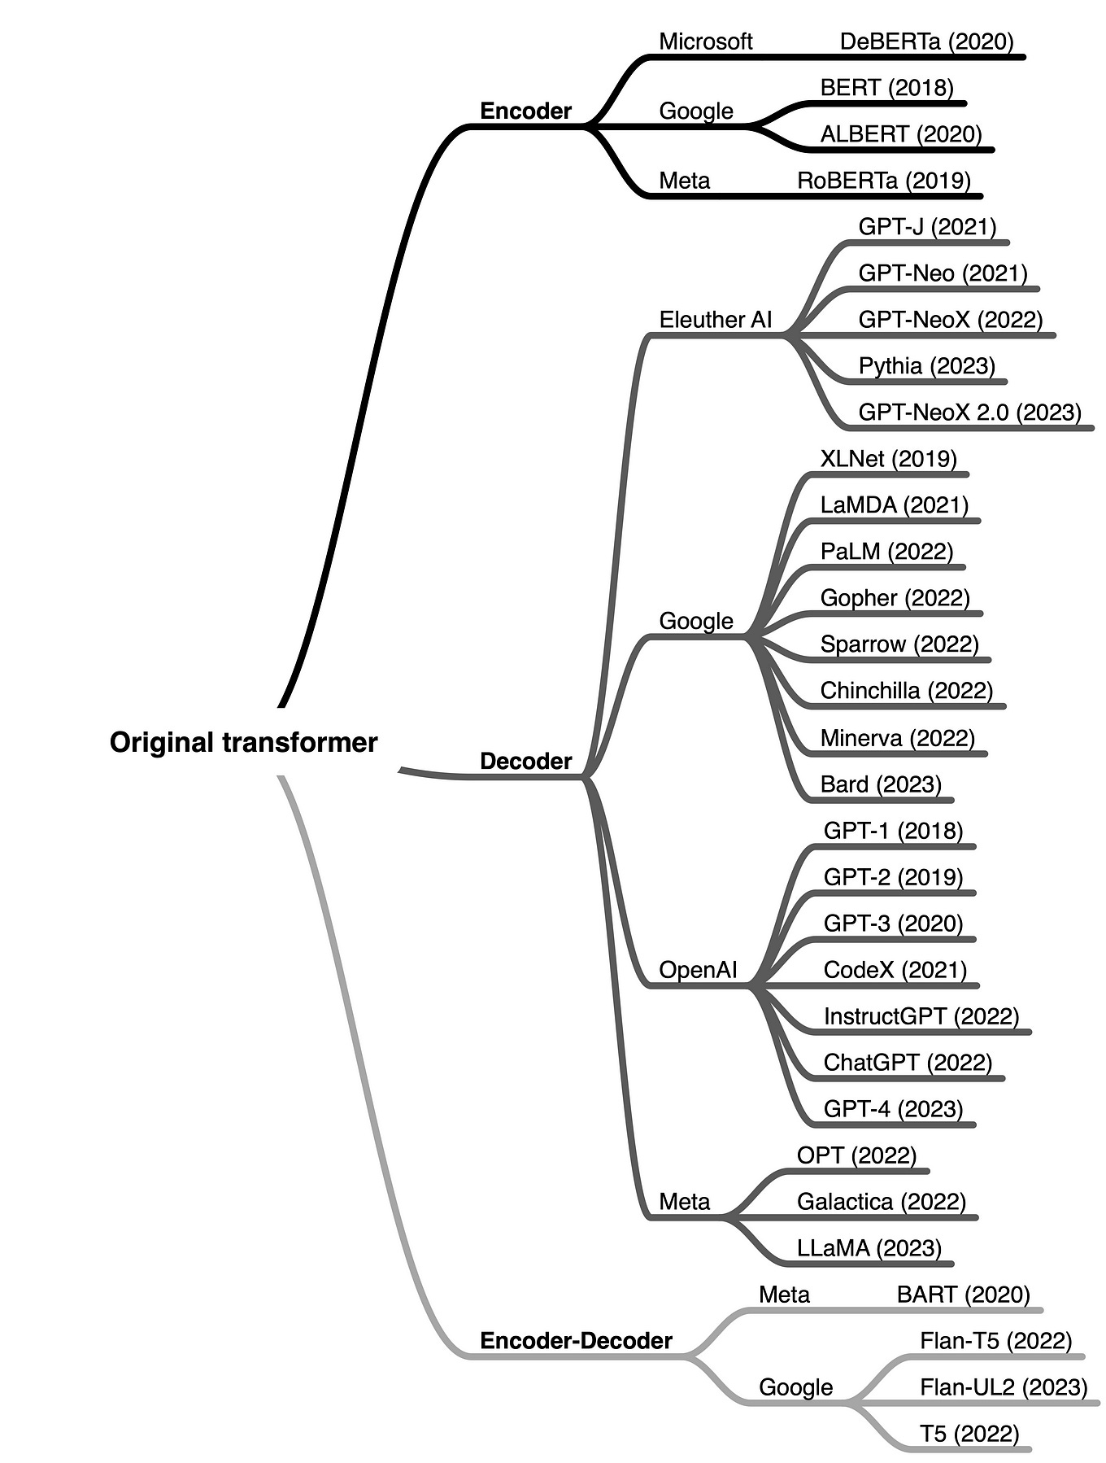
Types of transformers
Encoder:
Most suitable for text classification and information retrieval
“Context" of a word on both sides
Decoder:
Most suitable for text generation
“Context" is only the previous words
Most popular approach!
Encoder-decoder:
Different models for input and output
Used in e.g. machine translation

Slide 12
Multilingual or not?
Some LLMs are trained for a specific language
For Norwegian: NorBERT, NorGPT, etc.
Need a sufficiently large training set (the Norwegian Collossal Corpus from the National Library)
Others are trained on generic web content
Can work on many languages
But high imbalance when it comes to cultural references etc.
“ChatGPT is multilingual but monocultural” (Jill Walker Rettberg)

Slide 13
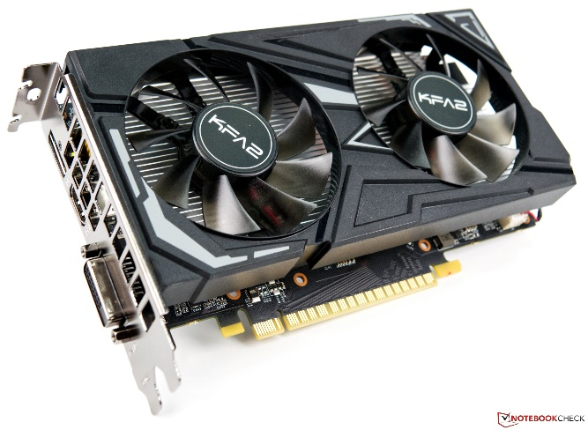
Training
leading
research-intensive
?
public
The University of Oslo is a
highly
LLMs are optimized (or trained) to predict the next word in a text
Training = gradual change of parameters so that the model predictions get a little closer to the “ground truth“
Modern LLMs have hundreds of billions of parameters and are trained on special hardware called GPUs

Slide 14
Model adaptation
After training, the language model can be adapted to tasks other than predicting the next word:
E.g. respond to the user in a conversation, follow instructions, classify documents, summarize or translate texts, etc.
Several adaptation strategies:
Fine tuning
Prompting
Reinforcement learning

Slide 15
Fine-tuning
= “further training” of the LLM to perform a specific task
For example, classifying texts
Or mask sensitive personal data in a document
Typically based on domain-specific data
Many methods, depending on the language model, how much data you have collected, and available computing resources

Slide 16
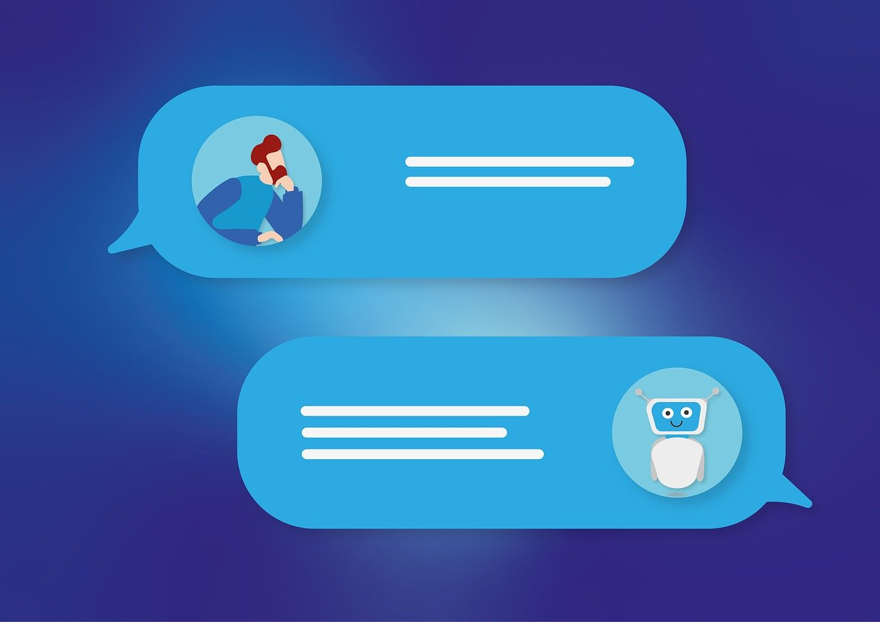
Prompting
A prompt is simply an instruction in text form that is given as input to a language model
Different formulations will give very different results!
One can also add examples of <input, output> in the prompt

Slide 17
Reinforcement learning
We can also adjust the language model by rewarding good answers and punishing bad answers
Step 1: estimation of a reward model from human judgments
Can also be used to prevent unwanted responses, e.g. hateful content
Step 2: optimization of the LLM to maximize the probability of receiving "thumbs up" for the answer

Slide 18
Outline
What are Large Language Models?
What can they be used for (esp. for researchers) ?
Challenges & new developments

Slide 19
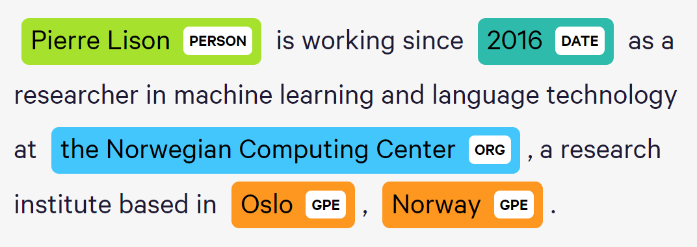
Document intelligence
Automated classification
Filtering
Sentiment analysis
Information extraction (entity recognition, relation extraction, etc.)
Text de-identification

Slide 20
Content creation
Autocomplete ++
Writing assistance (grammar checking, style suggestions, etc.)
«Co-pilot» for programmers
Text summarization

Slide 21
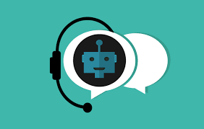
Other uses
Interactive systems (chatbots etc.)
Question answering (based on documents) & Information Retrieval
Machine translation
Speech processing

Slide 22
LLMs & digital humanities
Research with LLMs
Search & organize text materials
Transcribe audio transcripts
Translate multilingual content
Automated summaries
Writing assistance
Research on LLMs
Analysis of LLM-produced content (& how those are influenced by the underlying training data)
Societal aspects of LLM technology

Slide 23
Outline
What are Large Language Models?
What can they be used for (esp. for researchers) ?
Challenges & new developments

Slide 25
Challenge 1: Hallucinations
Language Models are optimized to produce plausible texts, not necessarily correct ones!
Incorrect answers may come from the training data, which may contain various types of errors or disinformation…
… But language models may still hallucinate with a “perfect” training set!
And often do so in an overly confident tone

Slide 26
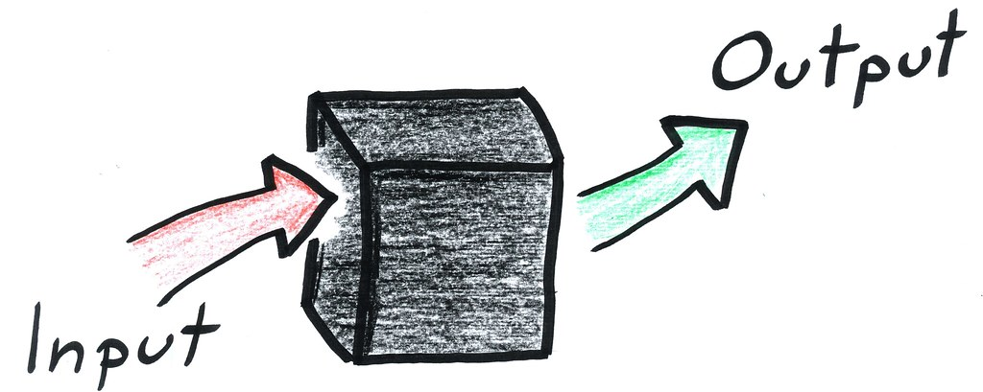
Challenge 2: Control
Language Models are “black-boxes”: we don’t really understand why they generate a given response
Three ways we can “steer” the model towards a desired behavior:
Prompting with specific instructions
Fine-tuning (= further training) on task-specific data
Reinforcement learning (reward good responses and punish bad ones)
➔ But the model may still behave in unpredictable ways …

Slide 27
Latest developments
Multimodal models: train the language model with more and richer data than just text: images, videos, audio, sensor data, etc.

Slide 28
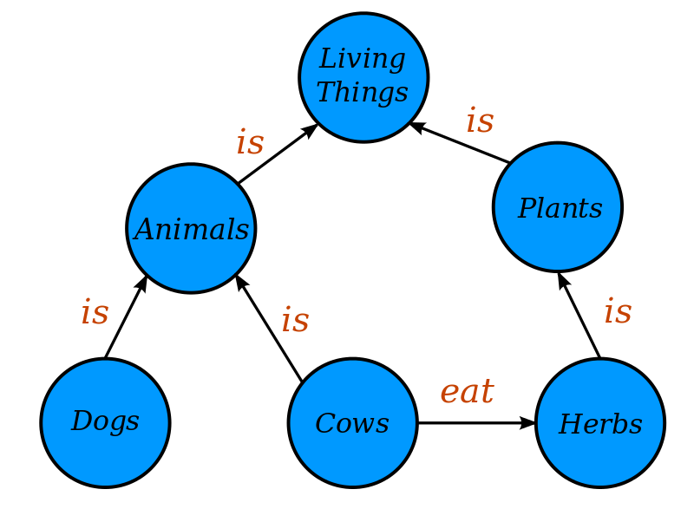
Latest developments
Benefits:
Reduces the risk of hallucinations
Better explainability
Easy to update the database
Integration of knowledge sources with retrieval-augmented models
Key idea: the language model first looks for relevant information in a text database and produces its answers based on it found

Slide 29
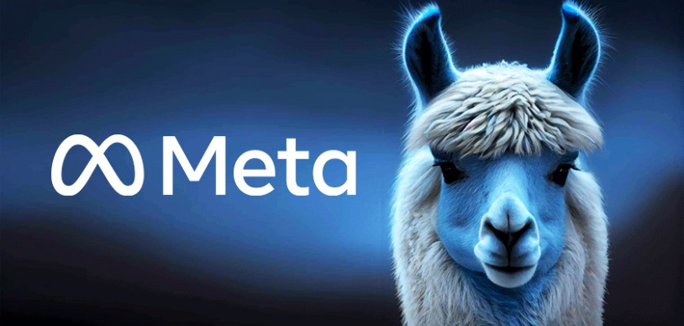
Latest developments
The rise of open-source language models (e.g. the Llama models developed by Meta)
→ Possible to use large language models without relying on cloud-based APIs that sends data on the web

Slide 30
Outline
What are Large Language Models?
What can they be used for (esp. for researchers) ?
Challenges & new developments
Conclusion

Slide 31
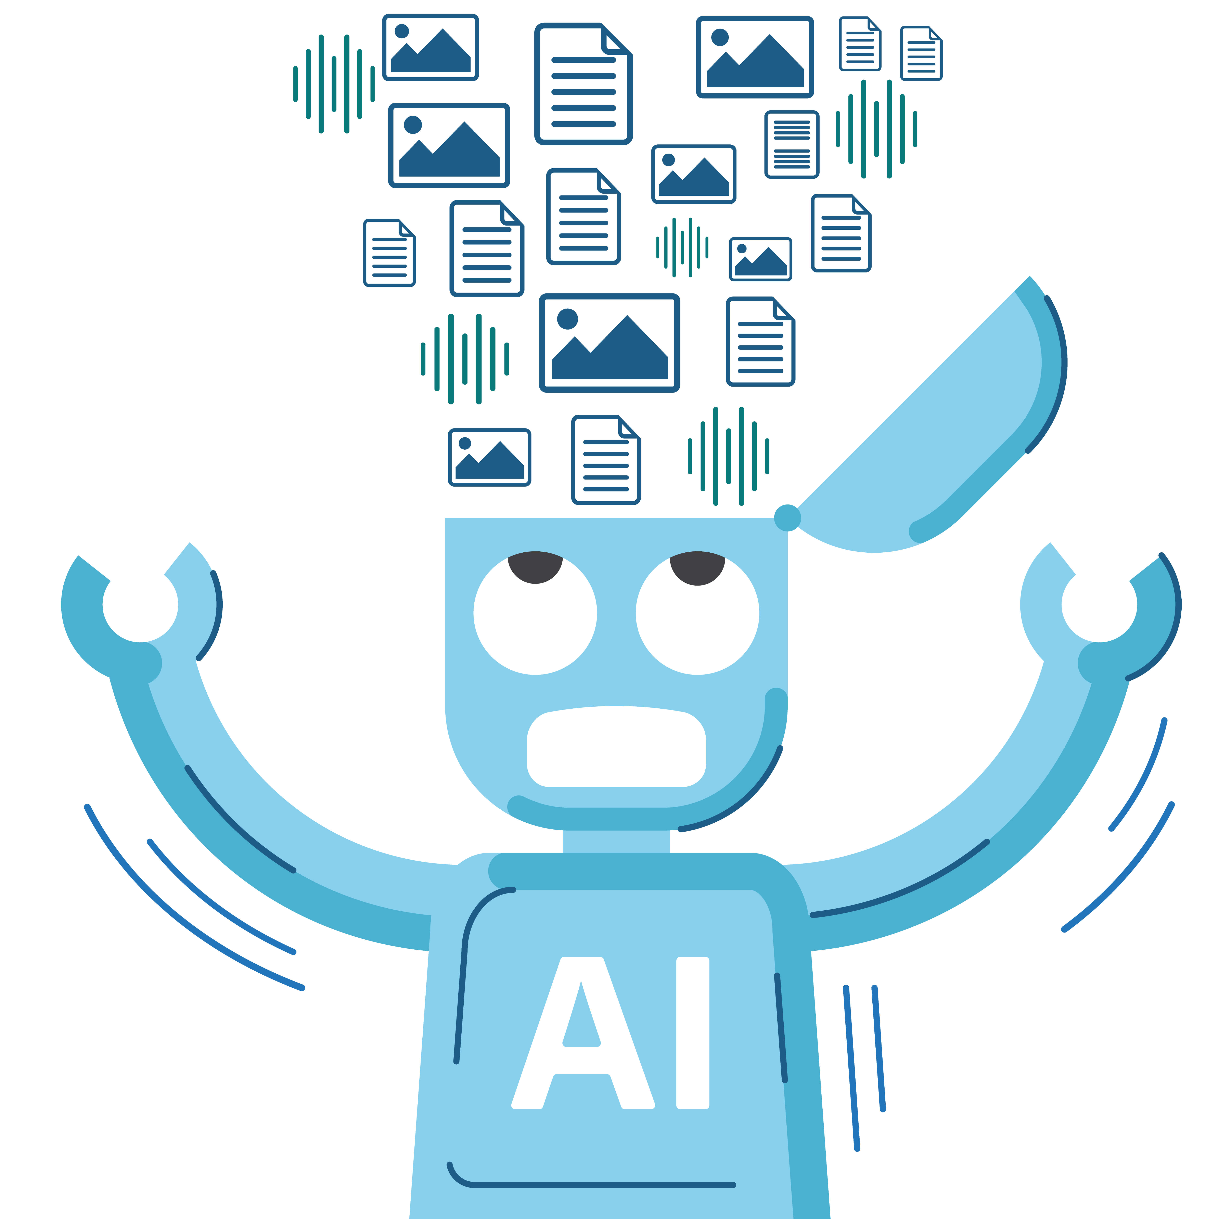
Take-home messages
Large Language Models are powerful tools that can be applied to a wide array of language processing tasks:
“Document intelligence”: information extraction, classification, filtering
Writing assistance: transcription, translation, summarization, “co-pilots”
But we also need to be aware of their limitations
… And discuss how to regulate their deployment (notably in terms of accountability, transparency & data protection)

