Slide 1
Privacy-enhancing NLP: A Primer
Pierre Lison
Norwegian Computing Center (NR)
& University of Oslo
plison@nr.no
Invited talk, MIKE
June 30, 2023

Slide 2
Privacy
= a fundamental human right:
Protected through various national and international legal frameworks (such as GDPR in Europe)
Common definition: ability of individuals, groups or organisations to seclude information about themselves selectively (Westin, 1967)
No one shall be subjected to arbitrary interference with his privacy, family, home or correspondence, nor to attacks upon his honour and reputation.
Everyone has the right to the protection of the law against such interference or attacks.
United Nations Declaration of Human Rights, 1948, Article 12

Slide 3
Privacy
GDPR regulates the storage, processing and sharing of personal data
Personal data cannot be processed without a proper legal ground
Most important ground: the consent of the individual
Consent must be freely given, explicit & informed
Other possible grounds: Contract, Legitimate Interest, Vital Interest, Legal Requirement, Public Interest
= any data related to an identified or identifiable individual

Slide 4
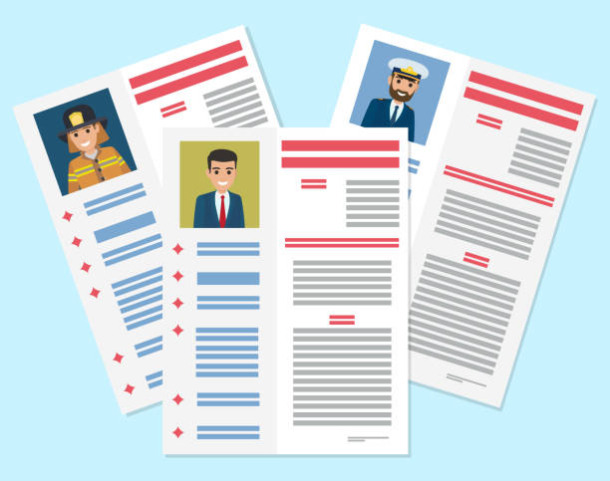
NLP and privacy
Text documents typically contain a lot of personal information
About the author of the text
About the persons mentioned/described in the text
2 central questions for NLP practitioners:
How can we train more “privacy-aware” NLP models?
How can we use NLP to (automatically or semi-automatically) mask personal information from text?

Slide 5
Some key problems
Text de-identification / sanitization
Editing a text document to mask personal information
(while retaining the rest of the content)
Text obfuscation
Transforming a document to conceal some sensitive
demographic attributes (e.g., gender, ethnicity)
Synthetic text generation
Generating new documents as “close” as possible to the
original ones (but with fictive personal data)
Training of privacy-preserving NLP models
Learning machine learning models or latent vector
representations with privacy guarantees

Slide 6
Anonymisation
(in the GDPR sense of the word)
= Complete & irreversible removal from the data of all information that may lead (directly or indirectly) to an individual being identified
Must filter out all direct identifiers: names, bank accounts, mobile phones, home addresses, social security numbers, etc
But also quasi-identifiers that do not identify a person in isolation, but may do so when combined (with background knowledge): places, organisations, dates, demographic attributes, etc.

Slide 7
Our answer: it depends on how one interprets GPDR!
Strict interpretation: no, unless the original data is deleted
Risk-based interpretation: difficult, but possible

Slide 8
Anonymisation of unstructured data
Main problem: requirement of unlikability with original dataset
➔ If one has access to the original data, it is quite easy to do a phrase search to find back the original document
Edit operations (e.g. masking personal identifiers)
Original collection of documents
Search for document containing same words/phrases
“Anonymized” version of the document

Slide 9
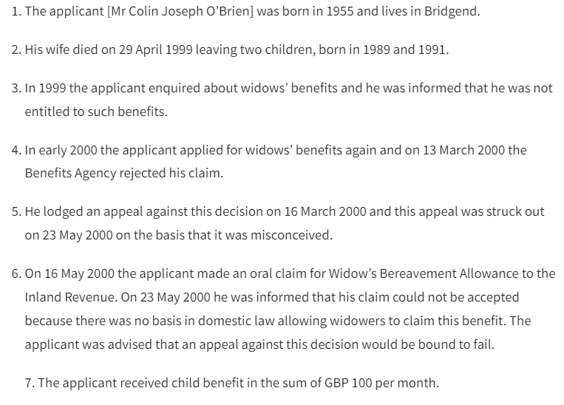
A simple experiment
Excerpt from an actual court case from the European Court of Human Rights (ECHR), nr. 61391/00:

Slide 10
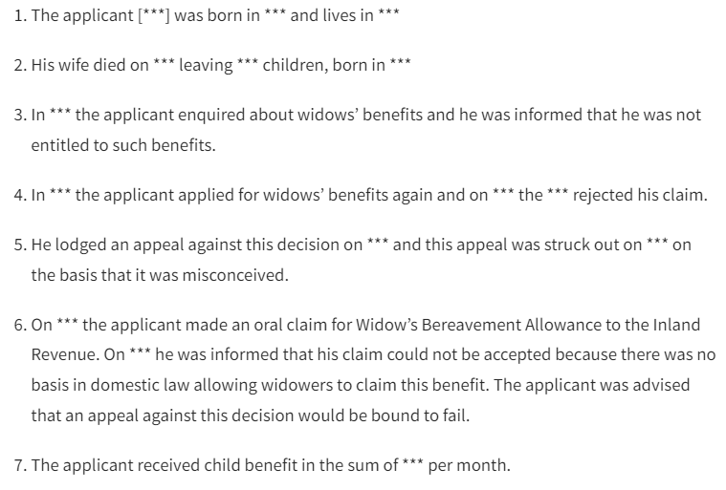
After masking direct and quasi identifiers, we obtain the following:
The masking decisions are here done manually by law students at the University of Oslo

Slide 11
Is this anonymous?
Combination of “rejected his claim” and “could not be accepted” also occurs once in the full dataset
“was advised that an appeal against” appears only once in a collection of 13,759 court cases!

Slide 12
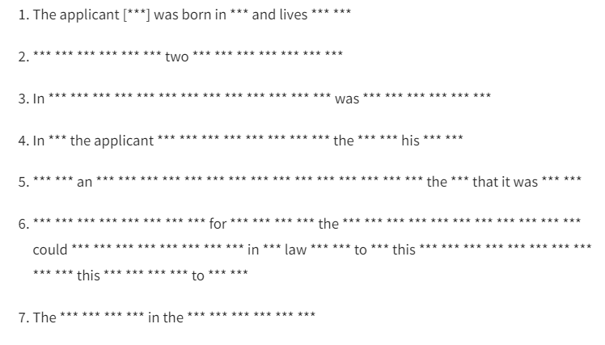
Full GDPR-compliant anonymisation:
If we want to truly eliminate the risk of linkage with the original set of documents, we end up with a worthless document:

Slide 13
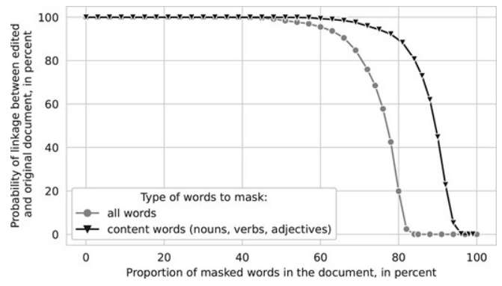
Full GDPR-compliant anonymisation:

Slide 14
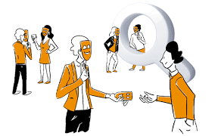
Text de-identification / sanitisation
Difficult to truly anonymise text documents in a GDPR-compliant manner
But text de-identification / sanitization still useful!
Much easier to argue for a public/legitimate interest if the privacy risks are reduced, and the benefits are clear!
Various de-identification techniques have been developed, both in NLP and in the field of Privacy-Preserving Data Publishing (PPDP)
[Lison, P., Pilán, I., Sánchez, D., Batet, M., & Øvrelid, L. (2021). Anonymisation models for text data: State of the art, challenges and future directions. In Proceedings of ACL 2021]

Slide 15
NLP methods
Meystre et al. (2010)
Aberdeen et al., 2010)
Yogarajan et al. (2018)
Typically framed as a sequence labelling problem:
Handcrafted patterns
Neural nets + domain adaptation
Largest application domain: clinical data
Notably the 2014 i2b2/UTHealth shared task (diabetic patient records) & the 2016 CEGS –NGRID shared task (psychiatric intake)
Dernoncourt et al. (2017)
Liu et al. (2017)
Hartman et al. (2020)
Stubbs and Uzuner (2015), Stubbs et al. (2017)

Slide 16
NLP methods
Limitations of sequence labelling methods:
Do not remove enough: limited to a predefined list of categories
Remove too much: removes all detected occurrences of those categories, regardless of disclosure risk
Dependent on manually annotated data

Slide 17
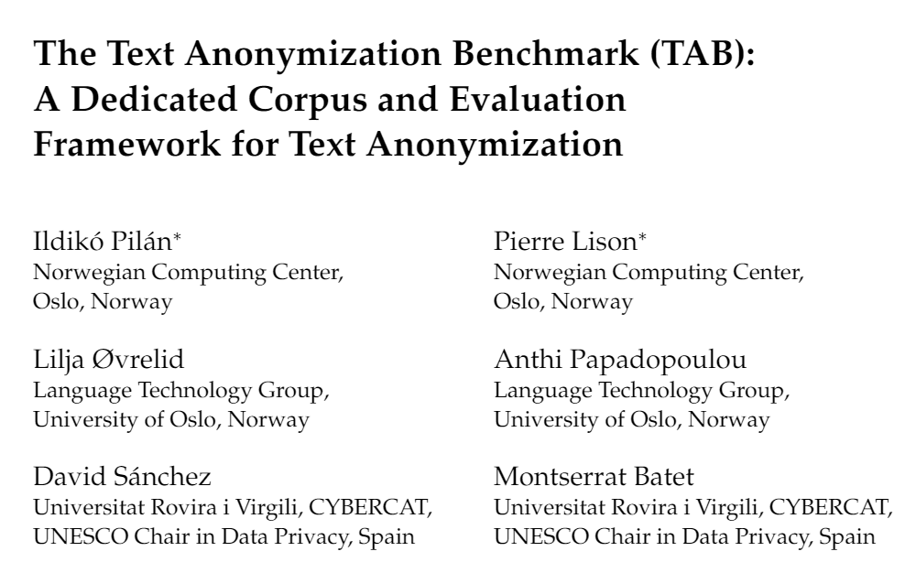
1278 court cases from the ECHR annotated for personal information:
Semantic type, masking decision, confidential attributes, co-reference relations, etc.
12 law students involved in the annotation (about 1000 hours in total!)
Pilán, I et al (2022). The text anonymization benchmark (TAB): A dedicated corpus and evaluation framework for text anonymization. Computational Linguistics, 48(4), 1053-1101.

Slide 18
Annotation process
Input: “Facts” section of an ECHR court case
+ name of person to protect in this document
Step 1: Detection of personal identifiers
8 categories: PERSON, CODE, ORG, LOC, DATETIME, QUANTITY, DEM, MISC
Step 2: Masking
Goal: decide which text spans identified in step 1 need be masked to conceal the identity of the person to protect
Assuming access to publicly available information (≈ the web)

Slide 19
Evaluation
De-identification methods often rely on classical IR metrics (P/R/F₁)
Three problems:
Not all personal identifiers are equally important to mask!
A personal identifier is only «protected» if all its occurrences are masked
Multiple possible solutions to a given de-identification problem
We present new evaluation metrics that:
Distinguish between direct and indirect identifiers
Operate at the level of entities, not mentions
Perform a micro-average over several annotators

Slide 20
Evaluation
Weighted precision on all identifiers
Precision on all personal identifiers
Recall on all personal identifiers
Entity-level recall on quasi identifiers
Entity-level recall on direct identifiers
Fine-tuned neural language models can catch most direct identifiers, but still struggle on some quasi-identifiers (especially text spans of type DEM and MISC)

Slide 21
Sanitization with explicit risk measures
Step 1 : privacy-enhanced entity recognition
Named entity recognition + Wikidata properties associated with human individuals
Step 2: privacy risk measures
Neural language models + Web search
Step 3: optimization
Search for solution that keep privacy risk below a threshold, but retain as much content as possible
High risk
High risk
Anthi Papadopoulou, Yunhao Yu, Pierre Lison and Lilja Øvrelid, «Neural Text Sanitization with Explicit Measures of Privacy Risk», AACL 2022.

Slide 22
Some key problems
Text de-identification / sanitization
Editing a text document to mask personal information
(while retaining the rest of the content)
Text obfuscation
Transforming a document to conceal some sensitive
demographic attributes (e.g., gender, ethnicity)
Synthetic text generation
Generating new documents as “close” as possible to the
original ones (but with fictive personal data)
Training of privacy-preserving NLP models
Learning machine learning models or latent vector
representations with privacy guarantees

Slide 23
Obfuscation methods
Task: conceal some sensitive personal attributes (gender, ethnicity, sexual orientation, etc.)
Either from the text itself, or from latent representations derived from it
Lexical substitution
Adversarial learning
Reinforcement learning
Encryption
Protection against attribute disclosure
Reddy and Knight (2016)
Elazar and Goldberg (2018)
Friedrich et al (2019)
Xu et al. (2019)
Mosallanezhad et al. (2019)
Huang et al. (2020)

Slide 24
Obfuscation methods
A related problem is to conceal the identity of the author of a given text
= Transform the text (or its latent representation) to prevent authorship attribution based on linguistic and stylistic properties
Possible approaches:
Constrain the embeddings
Or add differentially-private noise
[Li, Baldwin & Cohn 2018]
[Fernandes et al 2019; Feyisetan et al 2019]

Slide 25
Text rewriting & synthesis
Task: transform texts (or latent representations of those texts) to satisfy a privacy guarantee
Often based on differential privacy
While simultaneously seeking to preserve as much semantic quality as possible
As measured by e.g. performance on downstream tasks such as classification
[Xu et al, 2019, Kirshna et al, 2021, Habernal 2021, 2022]

Slide 26
Training NLP models
Large neural language models are trained on huge amounts of text data crawled from the web
… along with a lot of personal data obtained without consent, and difficult to curate
Those language models can be trained in a differentially private manner
E.g. by adding noise to the gradients (DP-SGD)
But: performance drops and large computational overheads
McMahan et al (2017), Li et al (2021), Ponomareva et al (2022)

Slide 27
Conclusion
Privacy-enhancing NLP is a rapidly growing research area
At the intersection of privacy law, machine learning, NLP and data privacy
Many open problems waiting to be solved!
No “one-size fits all”: ≠ use cases → ≠ design choices
What kind of privacy risks do we wish to mitigate?
What kind of “edit operations” do we allow?

