Slide 1
Can we automatically anonymize text documents?
Pierre Lison
Cambridge Language Technology Seminar
19 May 2022

Slide 2
Short intro
Senior researcher at the Norwegian Computing Center + lecturer at the University of Oslo
Some of my research interests:
Dialogue systems and conversational modelling
Privacy-enhancing NLP
Weak supervision
Multilingual resources (OpenSubtitles)

Slide 3
Short intro
Senior researcher at the Norwegian Computing Center + lecturer at the University of Oslo
Some of my research interests:
Dialogue systems and conversational modelling
Privacy-enhancing NLP
Weak supervision
Multilingual resources (OpenSubtitles)
Focus of this talk
(but feel free to get in touch on any other topic!)

Slide 4
Outline
Text anonymization:
What is it?
Why does it matter?
Is it at all possible?
Approaches
TAB: Text Anonymisation Benchmark

Slide 5
Outline
Text anonymization:
What is it?
Why does it matter?
Is it at all possible?
Approaches
TAB: Text Anonymisation Benchmark

Slide 6
Why text anonymization?
Access to text documents with (sensitive) personal data crucial in many domains
Notably for scientific research, in medicine, social sciences, legal studies, etc.
Consent sometimes difficult to obtain!
Can we edit those documents such as to remove this personal information (yet retain as much content as possible) ?

Slide 7
What is anonymisation?
(in the GDPR sense of the word)
= Complete & irreversible removal from the data of all information that may lead (directly or indirectly) to an individual being identified
But also quasi-identifiers that do not identify a person in isolation, but may do so when combined (with background knowledge): places, organisations, dates, demographic attributes, etc.
Must filter out all direct identifiers: names, bank accounts, mobile phones, etc

Slide 8
What is anonymisation?
(in the GDPR sense of the word)
= Complete & irreversible removal from the data of all information that may lead (directly or indirectly) to an individual being identified
Removal of predefined categories of entities (like done in NER) is not enough!
Must consider how each textual element may influence the disclosure risk
(& the remaining data utility)

Slide 9
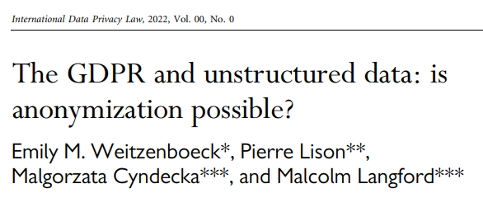
Our answer: it depends on how one interprets GPDR!
Strict interpretation: no, unless the original data is deleted
Risk-based interpretation: difficult, but possible

Slide 10
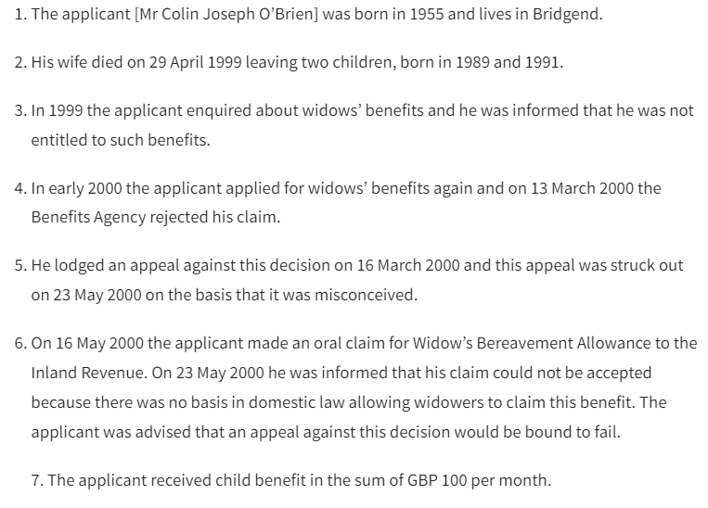
A simple experiment:
A short excerpt from a court case from the European Court of Human Rights [ECHR], nr. 61391/00:

Slide 11
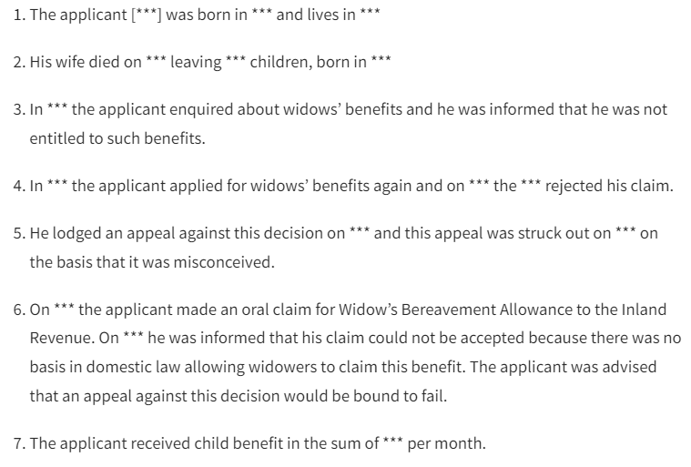
After masking (quasi-)identifiers
We asked law students to go through the texts, and mask (direct and indirect) identifiers which may lead to the re-identification of the individual mentioned in the document:

Slide 12
Is it anonymous?
Combination of “rejected his claim” and “could not be accepted” also occurs one in the full dataset
“was advised that an appeal against” appears only once in a collection of 13,759 court cases!

Slide 13
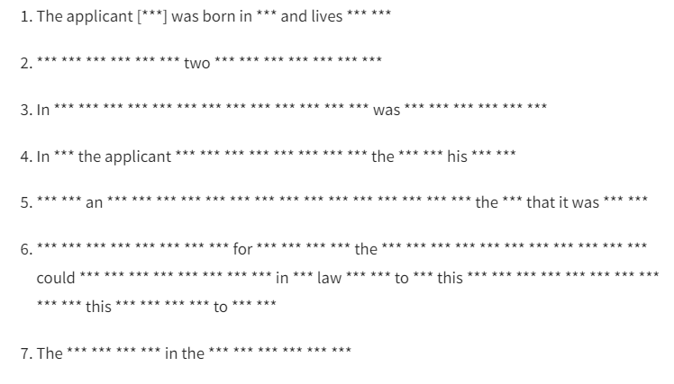
Full anonymisation
Theoretically possible to remove all unique phrases… but the result is worthless

Slide 14
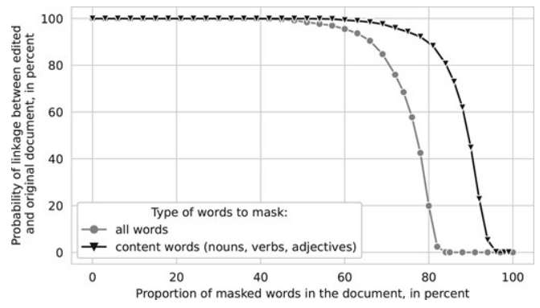
Text anonymisation

Slide 15
Outline
Text anonymization
Approaches:
Existing models
Current research
Three open challenges
TAB: Text Anonymization Benchmark

Slide 16
Text anonymization approaches
“Perfect” text anonymization may be impossible to achieve
But we can still build systems that make re-identification much harder (as a “privacy-enhancing” measure):
Given reasonable assumptions about the background knowledge available to an adversary
Editing/masking

Slide 17
NLP methods
Meystre et al. (2010)
Aberdeen et al., 2010)
Yogarajan et al. (2018)
Based on sequence labelling:
Handcrafted patterns or neural nets + domain adaptation
Require labelled data with predefined entity types
Largest application domain: clinical data
Notably the 2014 i2b2/UTHealth shared task (diabetic patient records) & the 2016 CEGS –NGRID shared task (psychiatric intake)
Dernoncourt et al. (2017)
Liu et al. (2017)
Hartman et al. (2020)
Stubbs and Uzuner (2015), Stubbs et al. (2017)

Slide 18
NLP methods
+ obfuscation methods to conceal particular personal attributes (gender, ethnicity, sexual orientation, etc.)
Either from the text itself, or from latent representations derived from it
Lexical substitution adversarial learning reinforcement learning encryption
Reddy and Knight (2016)
Elazar and Goldberg (2018)
Friedrich et al (2019)
Xu et al. (2019)
Mosallanezhad et al. (2019)
Huang et al., 2020
Useful and important techniques, but address a different problem than text anonymization

Slide 19
Privacy-preserving data publishing (PPDP)
= Privacy-first approach that explicitly reasons over disclosure risk based on a privacy model (often k-anonymity and its variants)
K-safety
K-confusability
t-plausibility
C-sanitize
Chakaravarthy et al. (2008)
Cumby and Ghani (2011),
Anandan et al. (2012)
Sánchez and Batet (2016, 2017)

Slide 20
Privacy-preserving data publishing (PPDP)
C-sanitize:
Inputs:
Document d (defined as a collection of terms)
List of individuals/entities C to protect in d
Background knowledge K
Output:
Edited document d’ such that the remaining terms no longer identify any individual/entity in C
Information-theoretic approach based on pointwise mutual information (PMI)
PMI estimated from web occurrence counts

Slide 21
Limitations
NLP methods:
Do not remove enough (restricted to predefined categories)
Remove too much (no account of disclosure risk)
Focus on detection, not editing
PPDP methods:
Documents reduced to “bags of terms”
Restricted types of semantic inferences
Scalability issues
➔ Can we somehow «combine» those two families of approaches?

Slide 22
Current work
Use a neural model to detect both direct & indirect personal identifiers
Compute estimators of privacy risk
Search for set of edit operations (mask or generalise) that ensure a privacy risk below a given threshold, yet minimize the semantic loss
PERSON
LOC
DEM
Use web queries & surprisal measures to determine the privacy risk for all entities, alone or in combination

Slide 23
Challenge 1: inferences
How to estimate the privacy risk?
Depends on the background knowledge expected to be available to an “adversary”
Most harmful inferences in text documents are semantic
(Montserrat Batet & David Sánchez, 2018)
= they are based on the actual meaning expressed in the texts instead of their statistical distributions

Slide 24
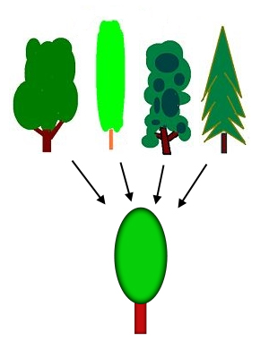
Challenge 2: masking
Most de-identification methods simply «black out» text spans
Loss of data utility!
Alternative: edit text spans instead of deleting them
Ex: «surgeon» → «health professional»
But how to we find the right generalisation?
Good starting point: ontologies
(Anandan et al., 2012; Sánchez and Batet, 2016)

Slide 25
Challenge 3: evaluation
Current systems often evaluated with IR-based metrics: precision, recall, F₁
But not all personal identifiers are equally important!
Those metrics also exclusively focus on the detection, not the editing
Need for human evaluations?
For instance re-identification attacks

Slide 26
Outline
Text anonymization
Approaches
TAB: Text Anonymization Benchmark

Slide 27
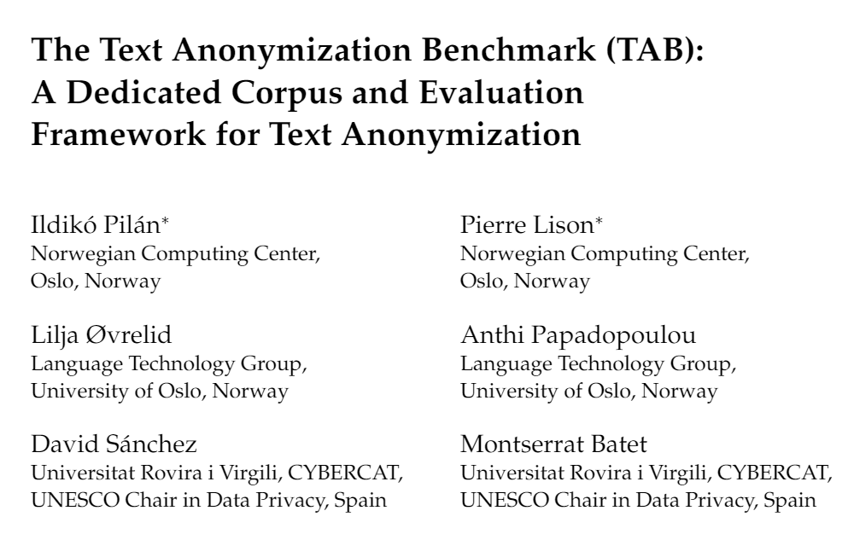
1278 court cases from the European Court of Human Rights (ECHR) annotated with personal information:
Semantic type
Masking decision
Confidential attributes
Co-reference relations
+ 12 law students involved in the annotation
(about 1000 hours in total!)

Slide 28
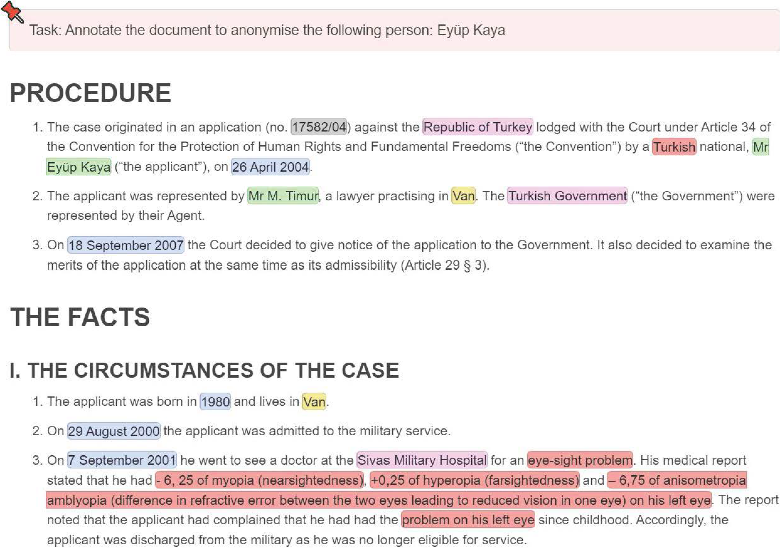
Find text spans that express personal information and classify them
Decide whether to mask (three options: DIRECT, QUASI or NO_MASK)
Is the span a confidential attribute (health info, ethnicity, etc.)?
Annotate co-reference relations

Slide 29
The TAB corpus
We also propose new evaluation metrics dedicated to text anonymization
Why? Three reasons:
Some personal identifiers are much more important than others!
A (direct or indirect) identifier is only «protected» if all its occurrences are masked
Multiple possible solutions to a given anonymisation problem

Slide 30
The TAB corpus
An entity is counted as a TP only if all its mentions are masked
Proposed metrics:
Entity-level recall over direct identifiers
Entity-level recall over quasi-identifiers
Weighted precision over all identifiers
We also provide baseline results with a Longformer model fine-tuned on the training section of TAB
micro-averaged over all annotators
Each entity mention is weighted by its information content (estimated with BERT)

Slide 31
Baseline results (with Longformer)
Recall on all personal identifiers
Entity-level recall on quasi identifiers
(Uniform) Precision on all personal identifiers
Entity-level recall on direct identifiers
Weighted precision on all identifiers

Slide 32
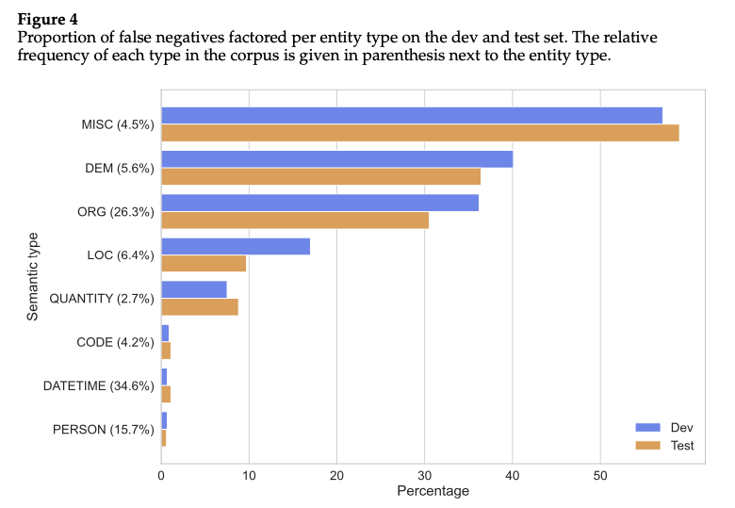
But…

Slide 33
Conclusion
Text anonymization: an important but difficult task at the intersection of NLP and data privacy
Need to manage trade-offs between privacy risk & data utility
The Text Anonymization Benchmark: a new dataset to evaluate and compare text anonymization methods!

Slide 34
Questions, comments?

