Slide 1
Privacy-enhancing NLP A short tutorial
Pierre Lison
plison@nr.no
Dagstuhl seminar on Privacy in Speech and Language Technology
August 22, 2022

Slide 2
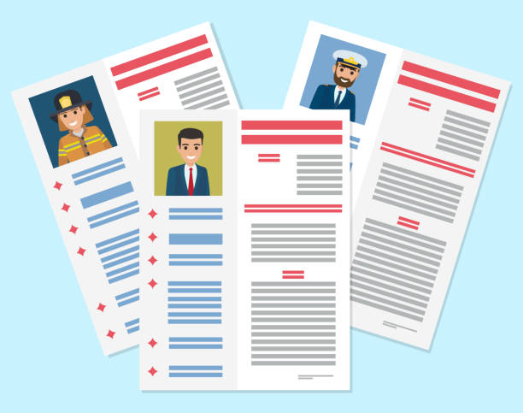
NLP and privacy
Text documents often contain personal information
About the author of the text
About the persons mentioned/described in the text
2 central questions for NLP practitioners:
How can we train more “privacy-aware” NLP models?
How can we use NLP to (automatically or semi-automatically) mask personal information from text?

Slide 3
NLP and privacy
NLP is both a blessing and a curse for privacy protection:
ML/NLP models can “leak” or be employed to extract & aggregate personal data on a large scale
But they can also be used to edit text documents for privacy-enhancing purposes
Privacy is a relatively recent concern in NLP
Exception: the de-identification of patient records

Slide 4
Some key problems
Text sanitization
Editing a text document to mask personal information
(while retaining the rest of the content)
Text obfuscation
Transforming a document to conceal some sensitive
demographic attributes (e.g., gender, ethnicity)
Synthetic text generation
Generating new documents as “close” as possible to the
original ones (but with fictive personal data)
Training of privacy-preserving NLP models
Learning machine learning models or latent vector
representations with privacy guarantees

Slide 5
Some key problems
Text sanitization
Editing a text document to mask personal information
(while retaining the rest of the content)
Text obfuscation
Transforming a document to conceal some sensitive
demographic attributes (e.g., gender, ethnicity)
Synthetic text generation
Generating new documents as “close” as possible to the
original ones (but with fictive personal data)
Training of privacy-preserving NLP models
Learning machine learning models or latent vector
representations with privacy guarantees

Slide 6
De-identification techniques
Handcrafted patterns & gazetteers
Sequence labelling (often with neural nets)
Require manually annotated data
Nowadays: typically fine-tuned from large pre-trained language models (BERT etc.)
Based on sequence labelling:
Handcrafted patterns or neural nets + domain adaptation
Largest application domain: clinical data
Meystre et al. (2010), Aberdeen et al., 2010)
Dernoncourt et al. (2017) , Liu et al. (2017), Yogarajan et al. (2018), Hartman et al. (2020)

Slide 7
Some challenges for de-identification models based on (neural) sequence labelling:
Do not remove enough (limited to a fixed, predefined list of categories to detect)
Remove too much (removes all detected occurrences, regardless of disclosure risk)
No account of disclosure risk
Dependent on manually annotated data

Slide 8
Privacy-preserving data publishing (PPDP)
= Privacy-first approach that explicitly reasons over disclosure risk based on a privacy model (often k-anonymity and its variants)
K-safety
K-confusability
t-plausibility
C-sanitize
Chakaravarthy et al. (2008)
Cumby and Ghani (2011),
Anandan et al. (2012)
Sánchez and Batet (2016, 2017)

Slide 9
Privacy-preserving data publishing (PPDP)
C-sanitize:
Inputs:
Document d (defined as a collection of terms)
List of individuals/entities C to protect in d
Background knowledge K
Output:
Edited document d’ such that the remaining terms no longer identify any individual/entity in C
Information-theoretic approach based on pointwise mutual information (PMI)
PMI estimated from web occurrence counts

Slide 10
Open challenges
Semantic inferences: how to model the adversary and their background knowledge?
Masking: how to best edit the text? (e.g. replace «St Wendel» by «[place in Germany]»)
Evaluation: how to measure the quality of text sanitization?

Slide 11
Some use cases
Electronic patient records
Notably the 2014 i2b2/UTHealth shared task (diabetic patient records) & the 2016 CEGS –NGRID shared task (psychiatric intake)
Court cases
See our recently released Text Anonymization Benchmark (TAB), based on ECHR judgments
Research materials in social science (interview transcripts etc.)
Stubbs and Uzuner (2015), Stubbs et al. (2017)
Pilán et al (2022), to appear in CL

Slide 12
Some key problems
Text sanitization
Editing a text document to mask personal information
(while retaining the rest of the content)
Text obfuscation
Transforming a document to conceal some sensitive
demographic attributes (e.g., gender, ethnicity)
Synthetic text generation
Generating new documents as “close” as possible to the
original ones (but with fictive personal data)
Training of privacy-preserving NLP models
Learning machine learning models or latent vector
representations with privacy guarantees

Slide 13
Obfuscation methods
Task: conceal some sensitive personal attributes (gender, ethnicity, sexual orientation, etc.)
Either from the text itself, or from latent representations derived from it
Lexical substitution adversarial learning reinforcement learning encryption
Reddy and Knight (2016)
Elazar and Goldberg (2018)
Friedrich et al (2019)
Xu et al. (2019)
Mosallanezhad et al. (2019)
Huang et al., 2020

Slide 14
Obfuscation methods
A related problem is to conceal the identify of the author of a given text
= Transform the text (or its latent representation) to prevent authorship attribution based on linguistic and stylistic properties
Possible approaches:
Constrain the embeddings
Or add differentially-private noise
[Li, Baldwin & Cohn 2018]
[Fernandes et al 2019; Feyisetan et al 2019]

Slide 15
Text rewriting & synthesis
Task: transform texts (or latent representations of those texts) to satisfy a privacy guarantee
Often based on differential privacy
While simultaneously seeking to preserve as much semantic quality as possible
As measured by e.g. performance on downstream tasks
[Xu et al, 2019, Kirshna et al, 2021, Habernal 2021]

Slide 16
Training NLP models
Large neural language models are trained on huge amounts of text data crawled from the web
… along with a lot of personal data obtained without consent, and difficult to curate
Those language models can be trained in a differentially private manner
E.g. by adding noise to the gradients (DP-SGD)
But often at the cost of performance drops and large computational overheads
McMahan et al (2017), Li et al (2021),
Ponomareva et al (2022)

Slide 17
Conclusion
Privacy-enhancing NLP is a rapidly growing field, with many problems that remain to be solved
No “one-size fits all”: different use cases result in different design choices
Text sanitization: can only hide/generalize text spans, but not insert noise
While methods designed to “preprocess” text data before training a ML model should allow for larger transformations

