Slide 1
Two open challenges for Large Language Models
Pierre Lison
Norwegian Computing Center (NR)
& University of Oslo
April 13, 2023
«AI for breakfast» seminar series @ Simula

Slide 2
Large Language Models?
= Machine learning systems optimized to predict the next word in text
Deep neural network
(Transformer architecture)
with many billions of parameters
Trained on huge collections of texts crawled from the web (Wikipedia, books, web fora, etc.)
As a by-product of this “guessing game”, the neural model will gradually build up representations of both linguistic and world knowledge
This model can then be adapted for various text processing tasks (generate answers in a dialogue, follow instructions, summarize texts, etc.)

Slide 3
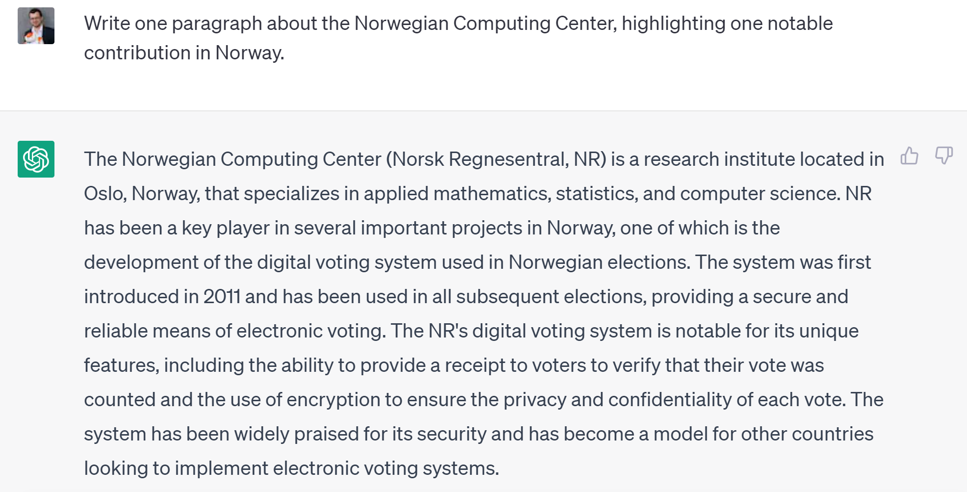
Challenge 1: Factuality
???

Slide 4
Challenge 1: Factuality
Language Models are optimized to produce plausible texts, not necessarily correct ones!
Incorrect answers may come from the training data, which may contain various types of errors or disinformation…
… But language models may still hallucinate with a “perfect” training set!
And often do so in an overly confident tone
Active research on “knowledge-augmented language models”
= language models able to draw information from external knowledge sources

Slide 5
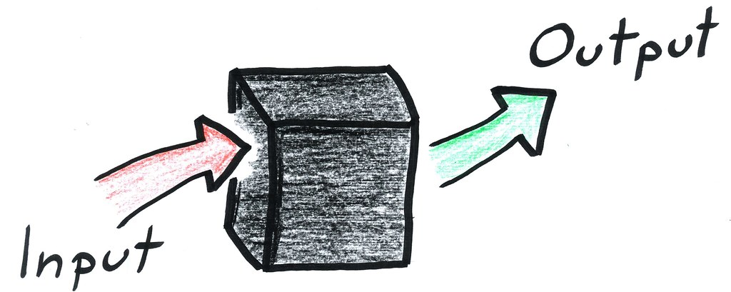
Challenge 2: Control
Language Models are “black-boxes”: we don’t really understand why they generate a given response
Three ways we can “steer” the model towards a desired behavior:
Prompting with specific instructions
Fine-tuning (= further training) on task-specific data
Reinforcement learning (reward good responses and punish bad ones)
➔ But the model may still behave in unpredictable ways …
Side problem: How to delete information from a language model? (cf. GDPR’s right to be forgotten)

Slide 6
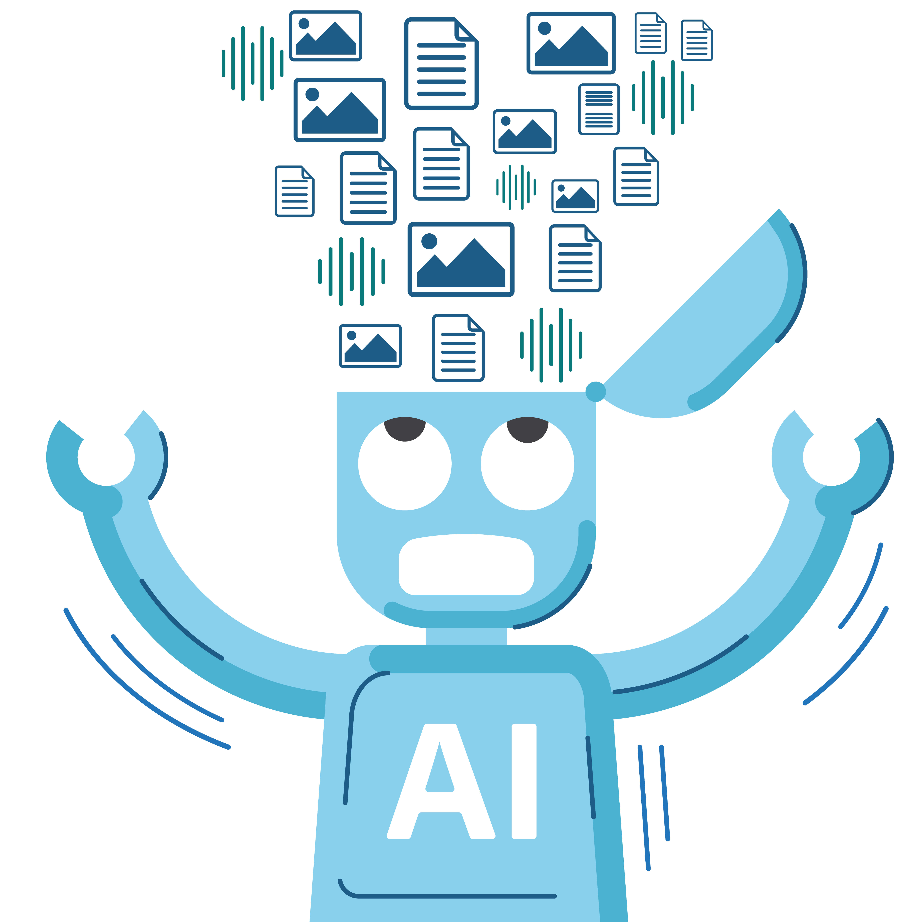
Take-home messages
Large Language Models are powerful tools that can be applied to a wide array of language processing tasks:
“Document intelligence”: information extraction, classification, filtering
Content creation: writing assistance, summarization, “co-pilots”
Interactive systems: chatbots, question-answering, personal assistants
But we also need to be aware of their limitations
… And start discussing how to regulate their deployment (notably in terms of accountability, transparency & data protection)

