Slide 1
Can we anonymise unstructured data?
Pierre Lison
plison@nr.no
27.04.2022
Finse Cyber-security Winter School
Notes:
And Pierre Lison at NR

Slide 2
Outline
What is unstructured data?
Can unstructured data be anonymized?
De-identification methods for text
Machine learning models
Concrete example
De-identification methods for images and speech

Slide 3
Outline
What is unstructured data?
Can unstructured data be anonymized?
De-identification methods for text
Machine learning models
Concrete example
De-identification methods for images and speech

Slide 4
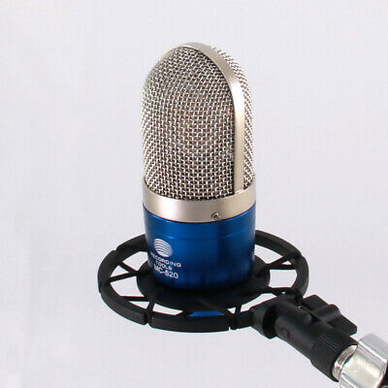
Unstructured data is everywhere
Industry estimates: up to 80% of the world's data in unstructured format (Gartner)

Slide 5
Unstructured data
= Umbrella term for various types of data that do not follow a predefined data model
Examples: text documents, pictures, web pages, audio/video recordings, emails, etc.
←→ Often contrasted with tabular data, defined with a fixed set of attributes, where each attribute is associated with a predefined range of possible values
Note: Many datasets actually “semi-structured” (combining e.g. numeric attributes with free-form fields)

Slide 6
Unstructured data
vs

Slide 7
Outline
What is unstructured data?
Can unstructured data be anonymized?
De-identification methods for text
Machine learning models
Concrete example
De-identification methods for images and speech

Slide 8
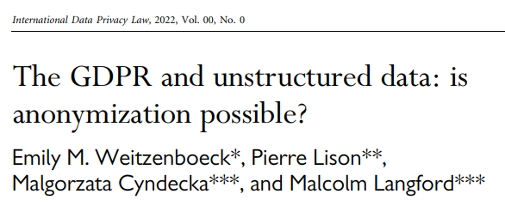
Our answer: it depends on how one interprets GPDR!
Strict interpretation: no, unless the original data is deleted
Risk-based interpretation: difficult, but possible

Slide 9
Anonymisation of unstructured data
Main problem: requirement of unlikability with original dataset
➔ If one has access to the original data, it is quite easy to do a phrase search to find back the original document
Edit operations (e.g. masking personal identifiers)
Original collection of documents
Search for document containing same words/phrases
“Anonymized” version of the document

Slide 10
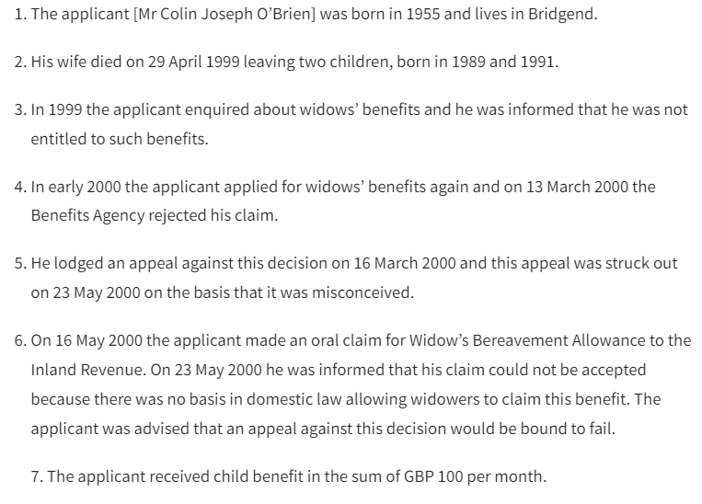
A simple experiment:
[excerpt from a court case from the ECHR, nr. 61391/00]

Slide 11
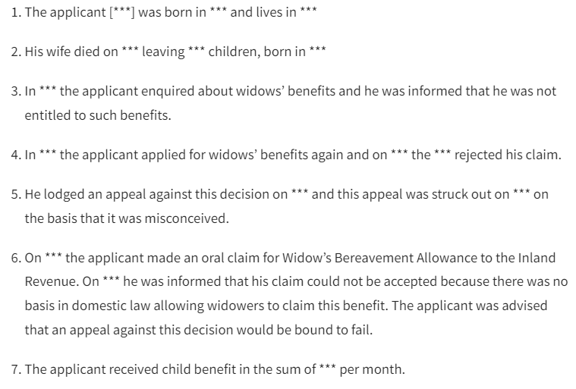
After masking (quasi-)identifiers
[Masking decisions made by law students from UiO]

Slide 12
Is it anonymous?
Combination of “rejected his claim” and “could not be accepted” also occurs one in the full dataset
“was advised that an appeal against” appears only once in a collection of 13,759 court cases!

Slide 13
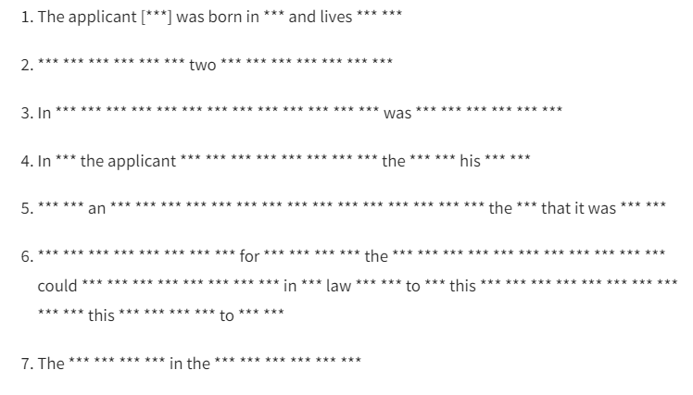
Full anonymisation
Theoretically possible to remove all unique phrases… but the result is worthless

Slide 14
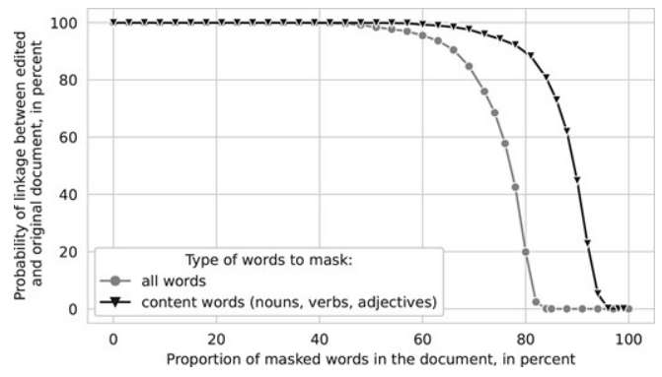
Text anonymisation

Slide 15
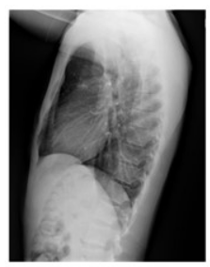
Image anonymisation
Experiment with 7570 chest X-ray images from the US National Library of Medicine
Not possible to recognize a person directly from the X-ray … but the hospital where the X-ray was taken has access to the patient name
Can we “distort” the image to ensure non-linkability?

Slide 16
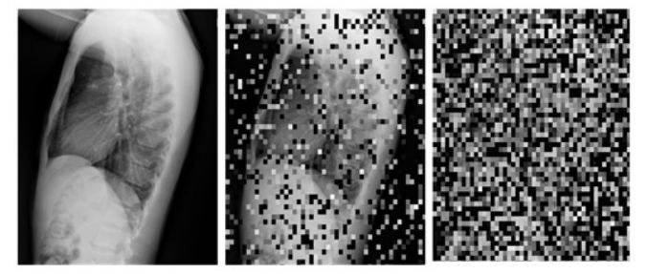
Image anonymisation
Can we “distort” the image to ensure non-linkability?
In theory, yes, for instance by introducing artificial noise
… but the image is essentially destroyed in the process:

Slide 17
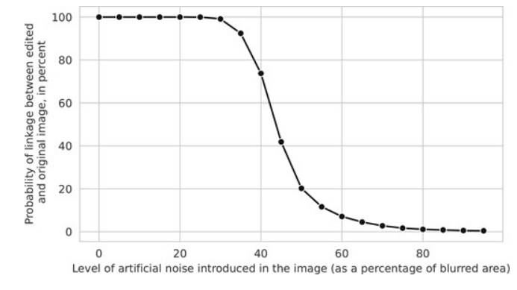
Image anonymisation

Slide 18
Outline
What is unstructured data?
Can unstructured data be anonymized?
De-identification methods for text
Machine learning models
Concrete example
De-identification methods for images and speech

Slide 19
De-identification methods
Simplest approach: handcrafted patterns
Regex to detect numbers, dates etc
Gazetteers to detect occurrences of specific words/phrases (compiled in a list)
Challenges:
Difficult to cover all types of entities
Cannot handle ambiguities (e.g. «Stein»)

Slide 20
De-identification methods
Nowadays, data-driven approaches (often based on deep neural networks) are dominant
De-identification as a sequence labelling problem:
BIO scheme: B(eginning), I(nside) or (O)ut of an entity
Models must be trained from (labelled) data

Slide 21
Sequence labelling
Beginning
Inside
Out
B-NAME
I-NAME
O
O
B-DATE
I-DATE
I-DATE
O
B-PLACE
O
O
O
Ola Normann , født 2. april 1978 i Drammen , kom til
akuttmottaket mandag 5. september på grunn av sterke
brystsmerter som viste seg å være en blodpropp….
O
B-DATE
I-DATE
I-DATE
O
O
O
B-SYMPTOM
I-SYMPTOM
O
O
O
O
O
O
B-DIAGNOSIS

Slide 22
Sequence labelling
[here, do some live coding to show how to use Spacy]

Slide 23
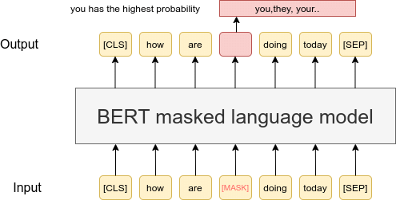
Neural language models
The best sequence labelling models are typically not learned “from scratch”, but fine-tuned from existing, large language models like BERT, GPT3 or T5

Slide 24
Neural language models
= Large neural models, with dozens of layers and billions of parameters
Each token represented by a numerical vector (=embedding)
Those word vectors are computed through multiple transformer layers where each token can be «influenced» by its neighbours using an attention mechanism
Task: predict missing words!

Slide 25
Fine-tuning
When doing fine-tuning of an existing model, we remove the top layer (specific to the word prediction task), but keep the other layers
We then add a new layer specific to our problem (like detecting named entities), and train this model on domain-specific data

Slide 26
Fine-tuning
[here, do some live coding with simpletransformers]

Slide 27
Pros & cons of sequence labelling approaches (for data privacy)
+ Good performance for detecting entities likes names, places, organisations, etc.
+ Can take context into account (to e.g. resolve ambiguities)
But:
- Does not remove enough (typically limited to predefined categories of entities, like named entities)
- May remove too much (remove all entities without considering the actual disclosure risk)

Slide 28
PPDP methods
Outside NLP, the field of privacy-preserving data publishing (PPDP) has also developed several text de-identification methods
Inputs:
Output:
Document d (represented as collection of terms)
Individuals/entities C to protect in d
Background knowledge K
Edited document d’ such that the remaining terms no longer identify anyone from C
Chakaravarthy et al. (2008), Cumby & Ghani (2011), Anandan et al. (2012), Sánchez and Batet (2016, 2017)

Slide 29
C-sanitize
Sánchez and Batet (2016, 2017)
Inputs:
Output:
Document d (represented as collection of terms)
Individuals/entities C to protect in d
Background knowledge K
Edited document d’ such that the remaining terms no longer identify anyone from C
Information-theoretic approach based on pointwise mutual information (PMI)
PMI estimated from web occurrence counts (background knowledge = “the web”)

Slide 30
PPDP methods
+ Explicit account of disclosure risk based on a privacy model (often k-anonymity)
+ Not limited to predefined entity types
But:
- Document reduced as a “bag of term”
- Restricted types of semantic inferences
- Scalability issues

Slide 31
CLEANUP project
Goal: reconcile NLP and PPDP approaches to text anonymization!
General procedure:
Use a neural model to detect personal (quasi-)identifiers
Compute various estimators of disclosure risk
Search for set of edit operations (mask or generalise) that can ensure a disclosure risk below a given threshold, yet minimize the semantic loss

Slide 32
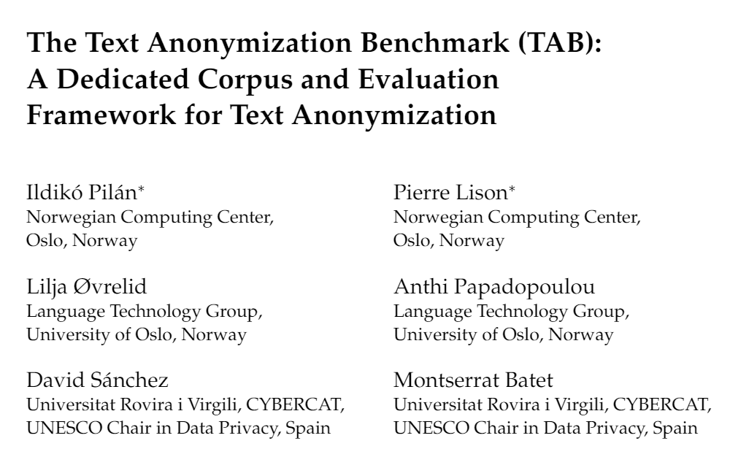
+ 12 law students involved in the annotation
(about 1000 hours in total!)
1278 court cases from the ECHR annotated for personal information:
Semantic type
Masking decision
Confidential attributes
Co-reference relations

Slide 33
The TAB corpus
We also propose new evaluation metrics dedicated to text anonymization
Why? Three reasons:
Not all personal identifiers are equally important to mask!
A (direct or indirect) identifier is only «protected» if all its occurrences are masked
Multiple possible solutions to a given anonymisation problem

Slide 34
Outline
What is unstructured data?
Can unstructured data be anonymized?
De-identification methods for text
Machine learning models
Concrete example
De-identification methods for images and speech

Slide 35
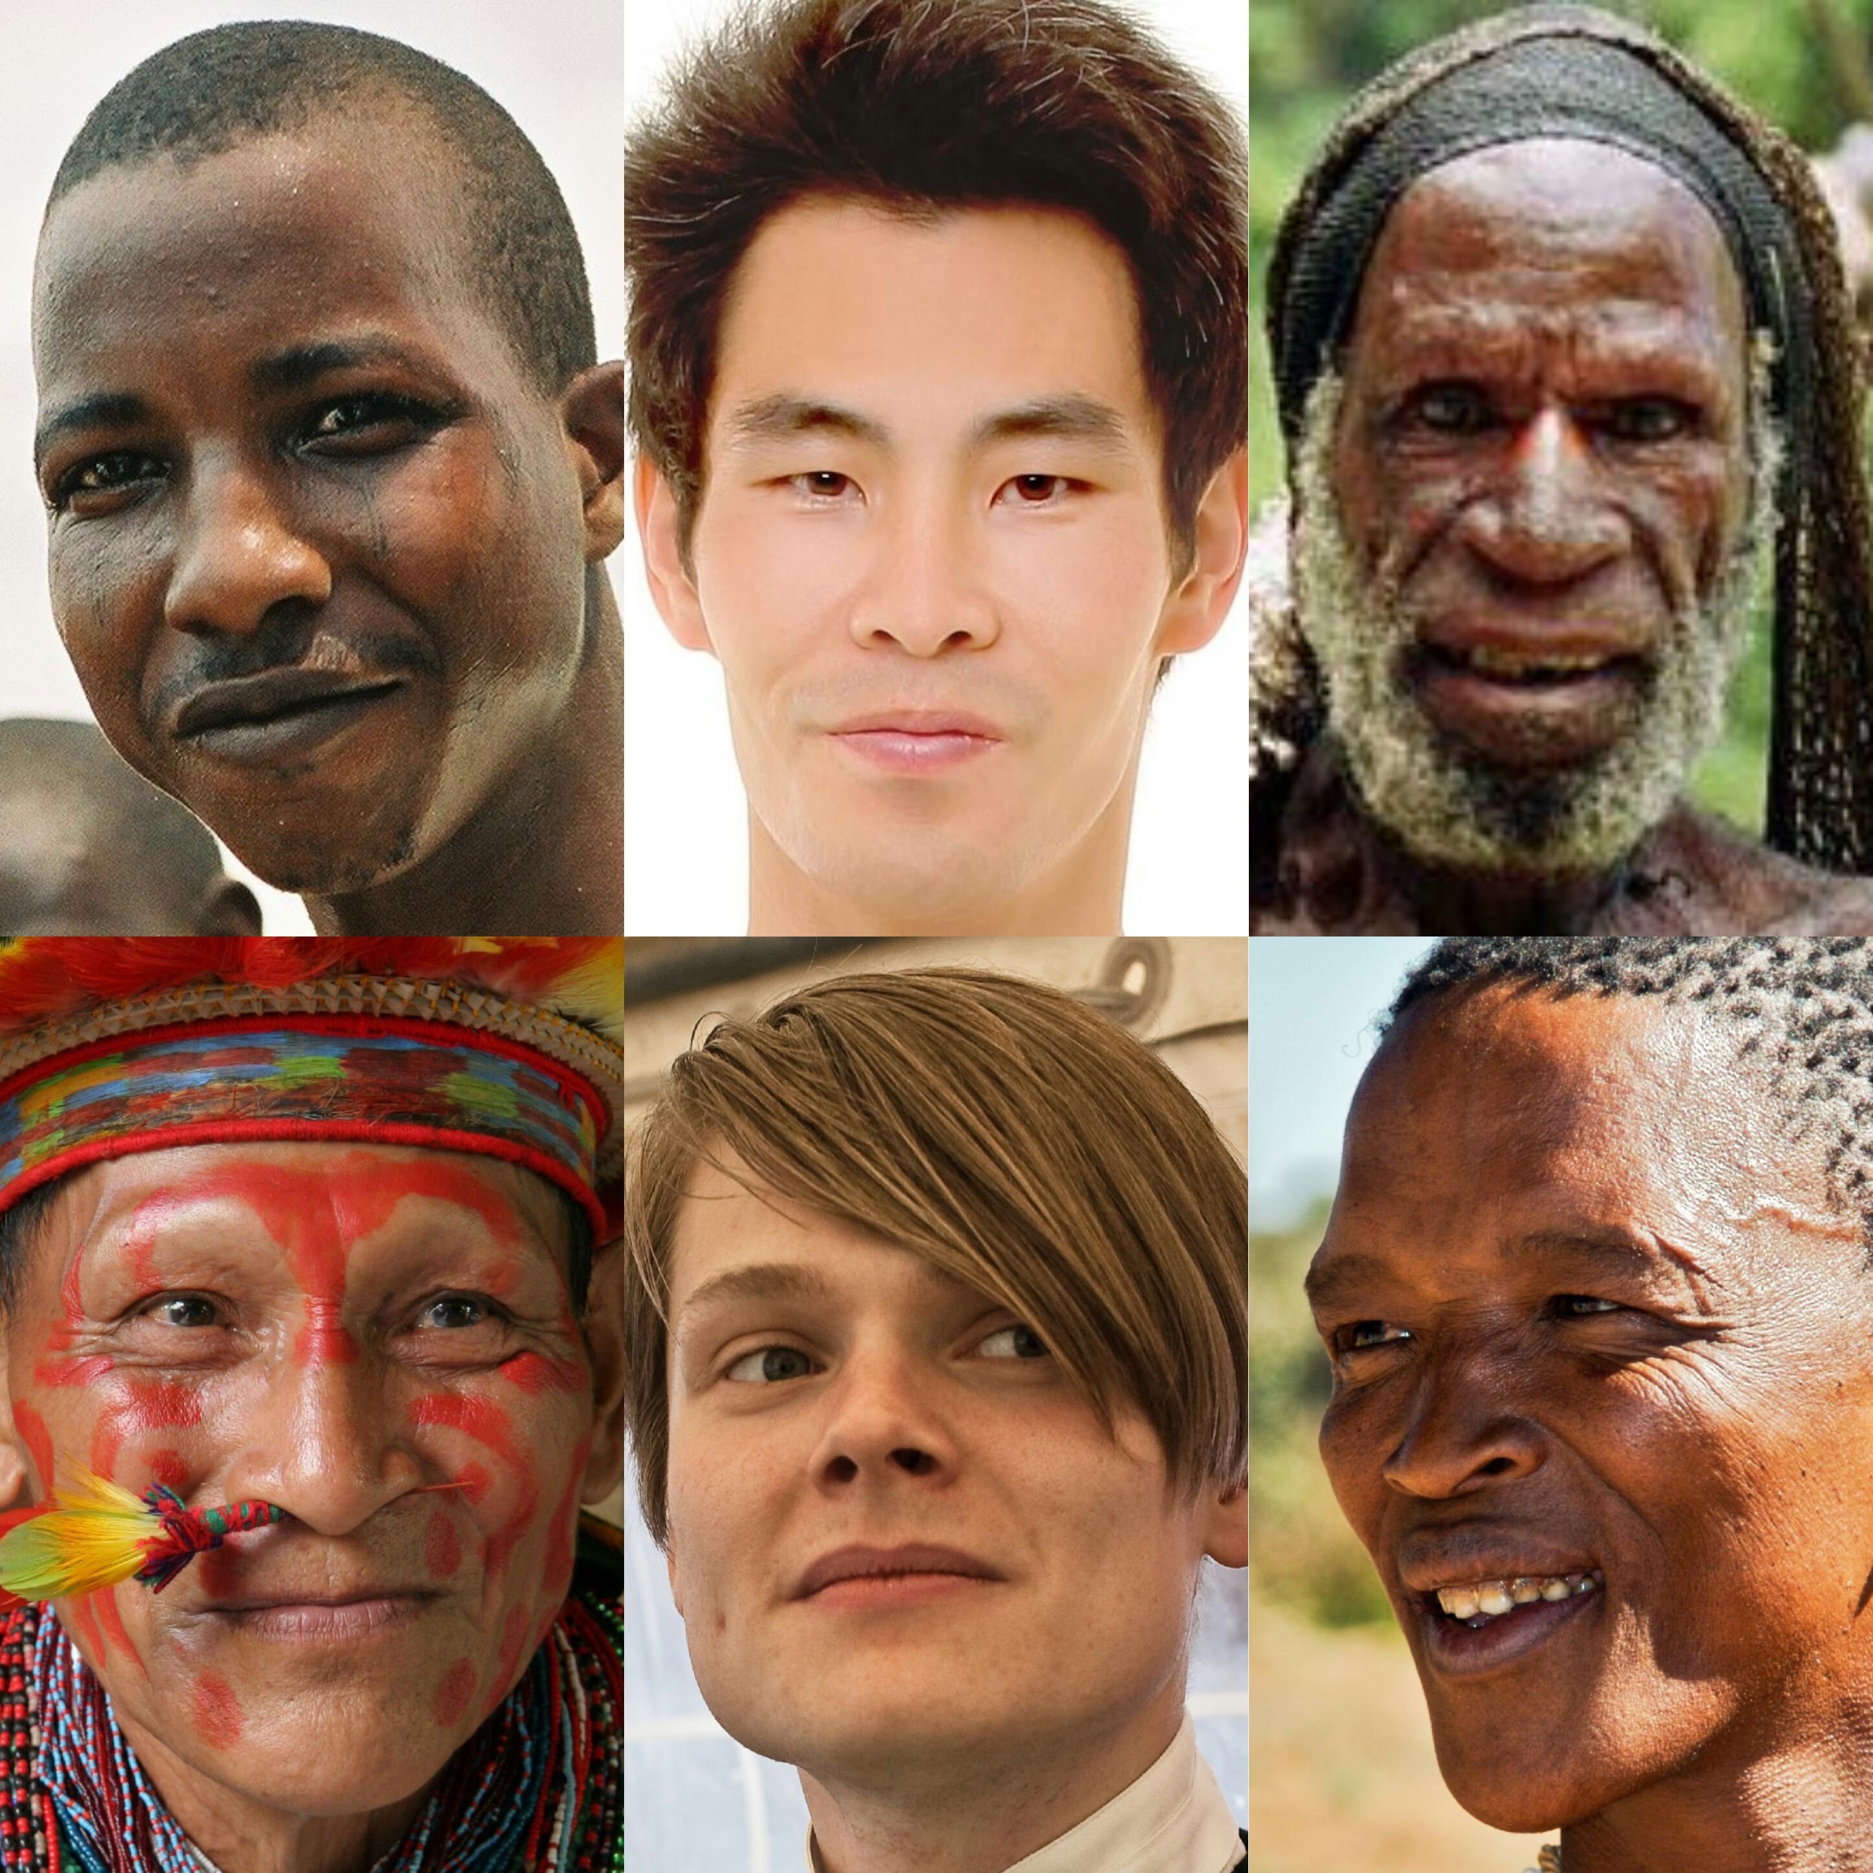
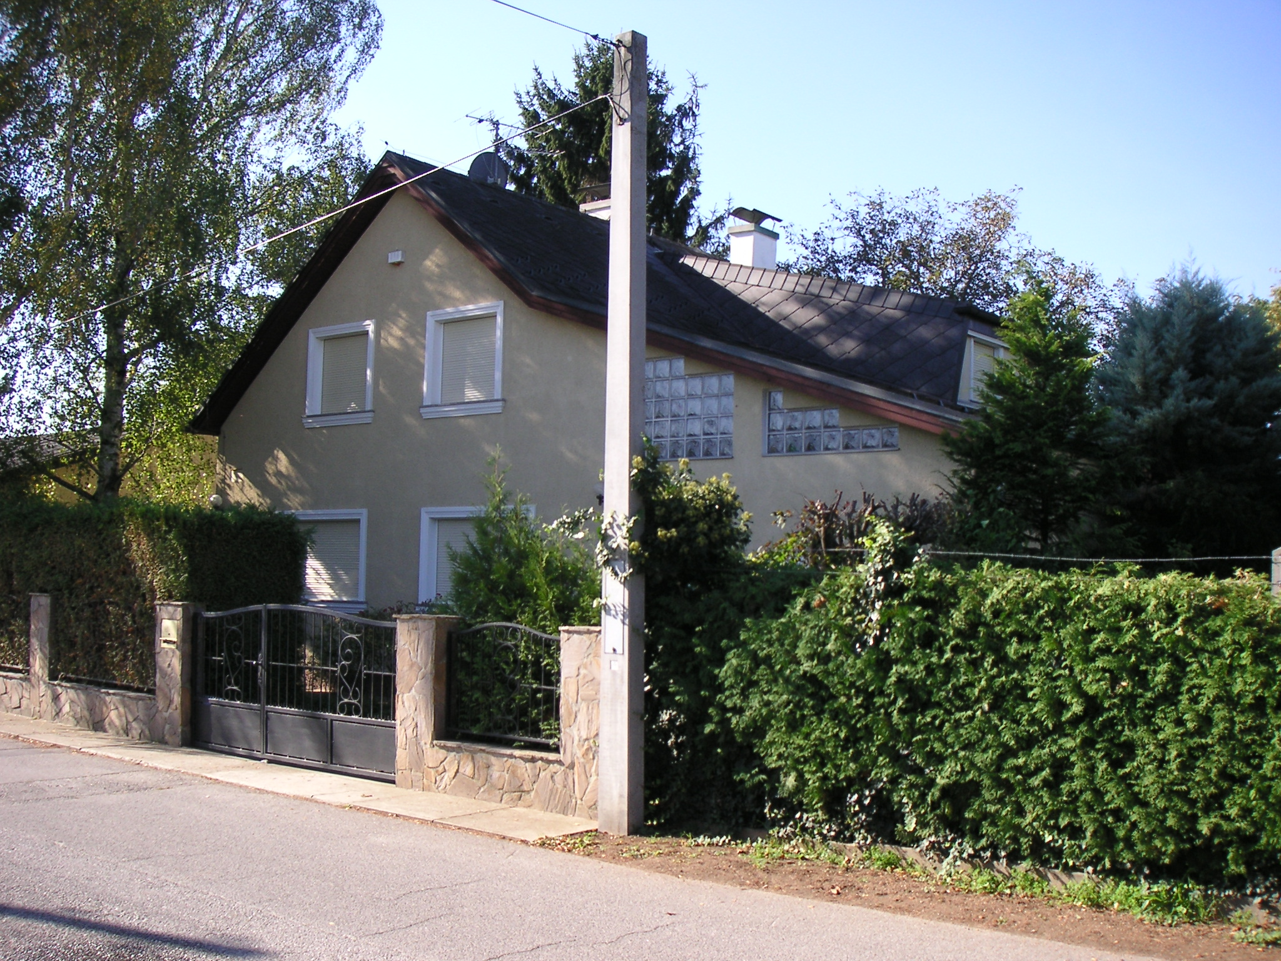
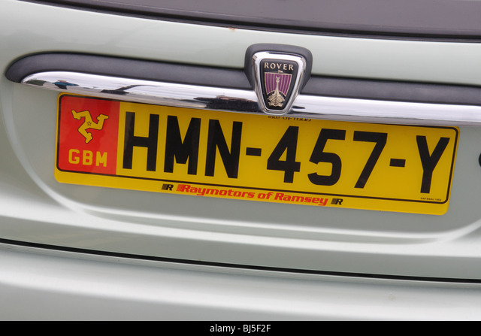
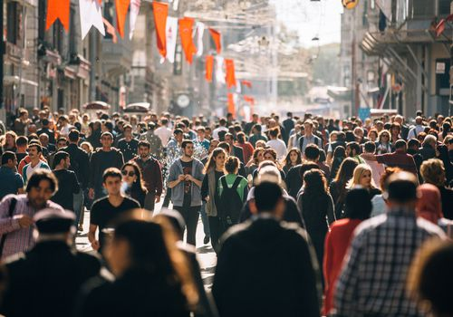
De-identification of images
Large range of personal data “expressed” in images

Slide 36
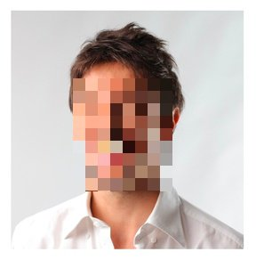
De-identification of images
The detection of human faces using deep neural nets can now be done with high accuracy
Once the bounding box of a face is extracted, one can easily apply a blurring filter to it
Same for specific items such as vehicle registration plates
But more indirect «cues» (clothing etc.) harder to handle

Slide 37
De-identification of images
[here, do some live coding with face_recognition]

Slide 38
De-identification of recordings
Speech is by definition personal data: one can recognize a person by their voice
It is possible to distort the voice of an individual to make it harder to identify
But it does not make the recording anonymous:
Individual speaking patterns, word choices etc
Content in what is being said

Slide 39
Questions, comments?

