Slide 1
CLEANUP: Machine Learning for the Anonymisation of Unstructured Personal data
Pierre Lison, NR
eHealth and Welfare Technologies and Services Research Projects Workshop
November 7, 2022

Slide 2
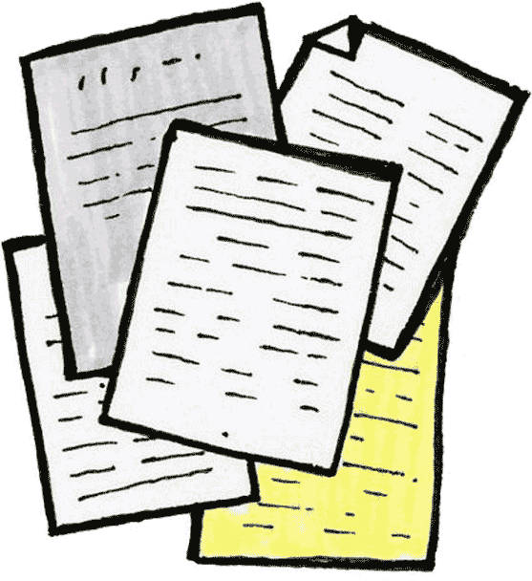
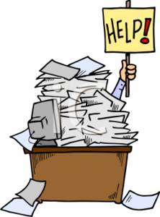
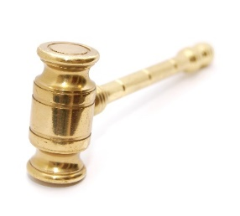
Free-form texts constitute a large part of the data we gather or produce:
Electronic health records
Court rulings
Case-handling notes
Interactions with clients
Etc.
Can we edit those documents to mask personally identifying information (PII)?

Slide 3
CLEANUP
Main goal: develop new machine learning methods to automatically sanitize text documents
Editing/masking

Slide 4
Text sanitization
Current state of the art: sequence labelling with fine-tuned neural language models
Limitations:
Does not remove enough (typically limited to named entities)
Removes too much (masks all detected occurrences of a given entity type, regardless of risk)
Lison, P, Pilán, I., Sánchez, D., Batet, M. and Øvrelid, L. (2021) Anonymisation Models for Text Data: State of the art, Challenges and Future Directions. ACL 2021.

Slide 5
Two-steps approach
Step 1 : privacy-enhanced entity recognition
Named entity recognition + Wikidata properties associated with human individuals
Step 2: privacy risk measures
Neural language models + Web search
Step 3: optimization
Search solution that keep privacy risk below a threshold, but retain as much content as possible
High risk
Anthi Papadopoulou, Yunhao Yu, Pierre Lison and Lilja Øvrelid, «Neural Text Sanitization with Explicit Measures of Privacy Risk», to be published at AACL 2022.

Slide 6
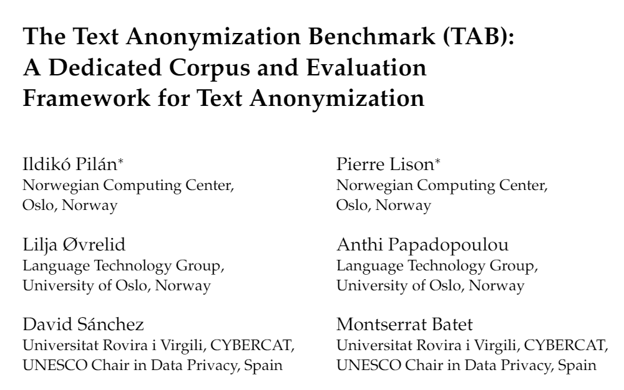
New dataset:
1278 court cases from the ECHR annotated for personal information:
Semantic type, masking decision, confidential attributes, co-reference relations, etc.
12 law students involved in the annotation (about 1000 hours in total!)
To appear in Computational Linguistics, December 2022
We also present new evaluation metrics to assess the quality of text sanitization methods
Both in terms of privacy protection and utility preservation

Slide 7
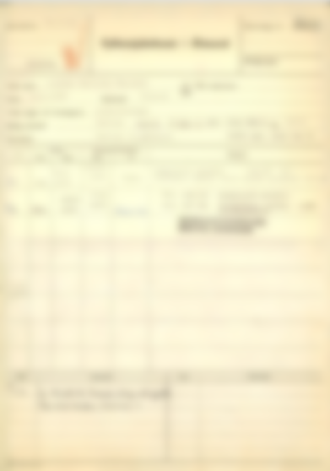
Patient records
Collaboration with the Norwegian Health Archives to sanitise patient archives
6 categories to detect: patient name, personal identification number, date of birth/death, name of relative, home address & contact information (phone numbers etc)
Main challenge: scanned PDFs as input!

Slide 8
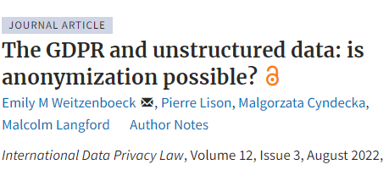
Can such sanitization process lead to GDPR-compliant anonymization?
Short answer: no.
(at least if one is unable/unwilling to delete the original dataset)

Slide 9
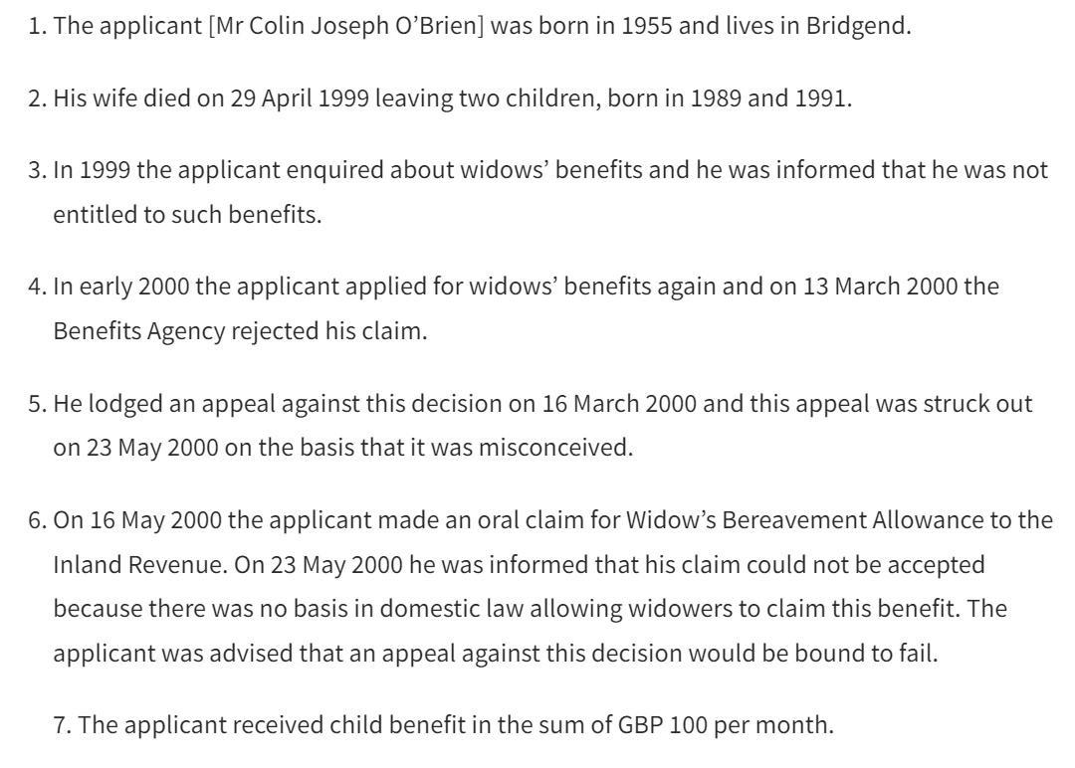
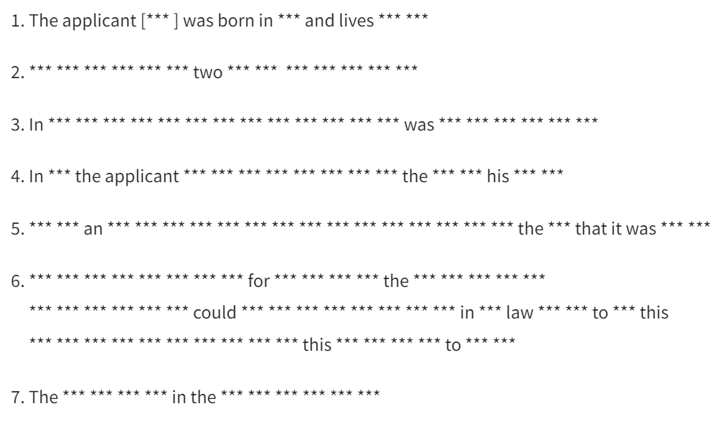

Slide 10
Take-home messages
Editing/masking
NLP can be employed to automatically or semi-automatically sanitize text documents
Including text data in electronic patient records
As always: balance between privacy and utility
But the output cannot be considered as anonymous

