Slide 1
Skweak – weak supervision made easy for NLP
Pierre Lison
Norwegian Computing Center (NR)
& University of Oslo
plison@nr.no
Invited talk, University of Gothenburg
March 10, 2023

Slide 2
The data problem
→ How can I get labelled data to train my model?
Lack of labelled data remains one of the most important problems when applying ML today!
Especially acute for:
Resource-poor languages
Less common text domains
Tasks relying on domain-specific categories (which may change over time!)

Slide 3
Possible solutions
Expensive & time-consuming!
+ must be repeated every time the data or tagset changes...
Collect & annotate our own training data and use it to train a new ML model
Use transfer learning to adapt an existing model
Use weak supervision to automatically annotate data from our target domain
Easier to scale, but still requires in-domain data for fine-tuning
Our focus

Slide 4
Weak supervision
Goal: train machine learning through “weaker / noisier” supervision signals obtained from different sources
Instead of relying on a single “gold standard”
Approach:
We start with some raw, unlabelled data
We apply several “labelling functions” (heuristics etc.) to obtain some (imperfect) labels of our data
We then aggregate together the labels
And we train our ML model on these aggregated labels

Slide 5
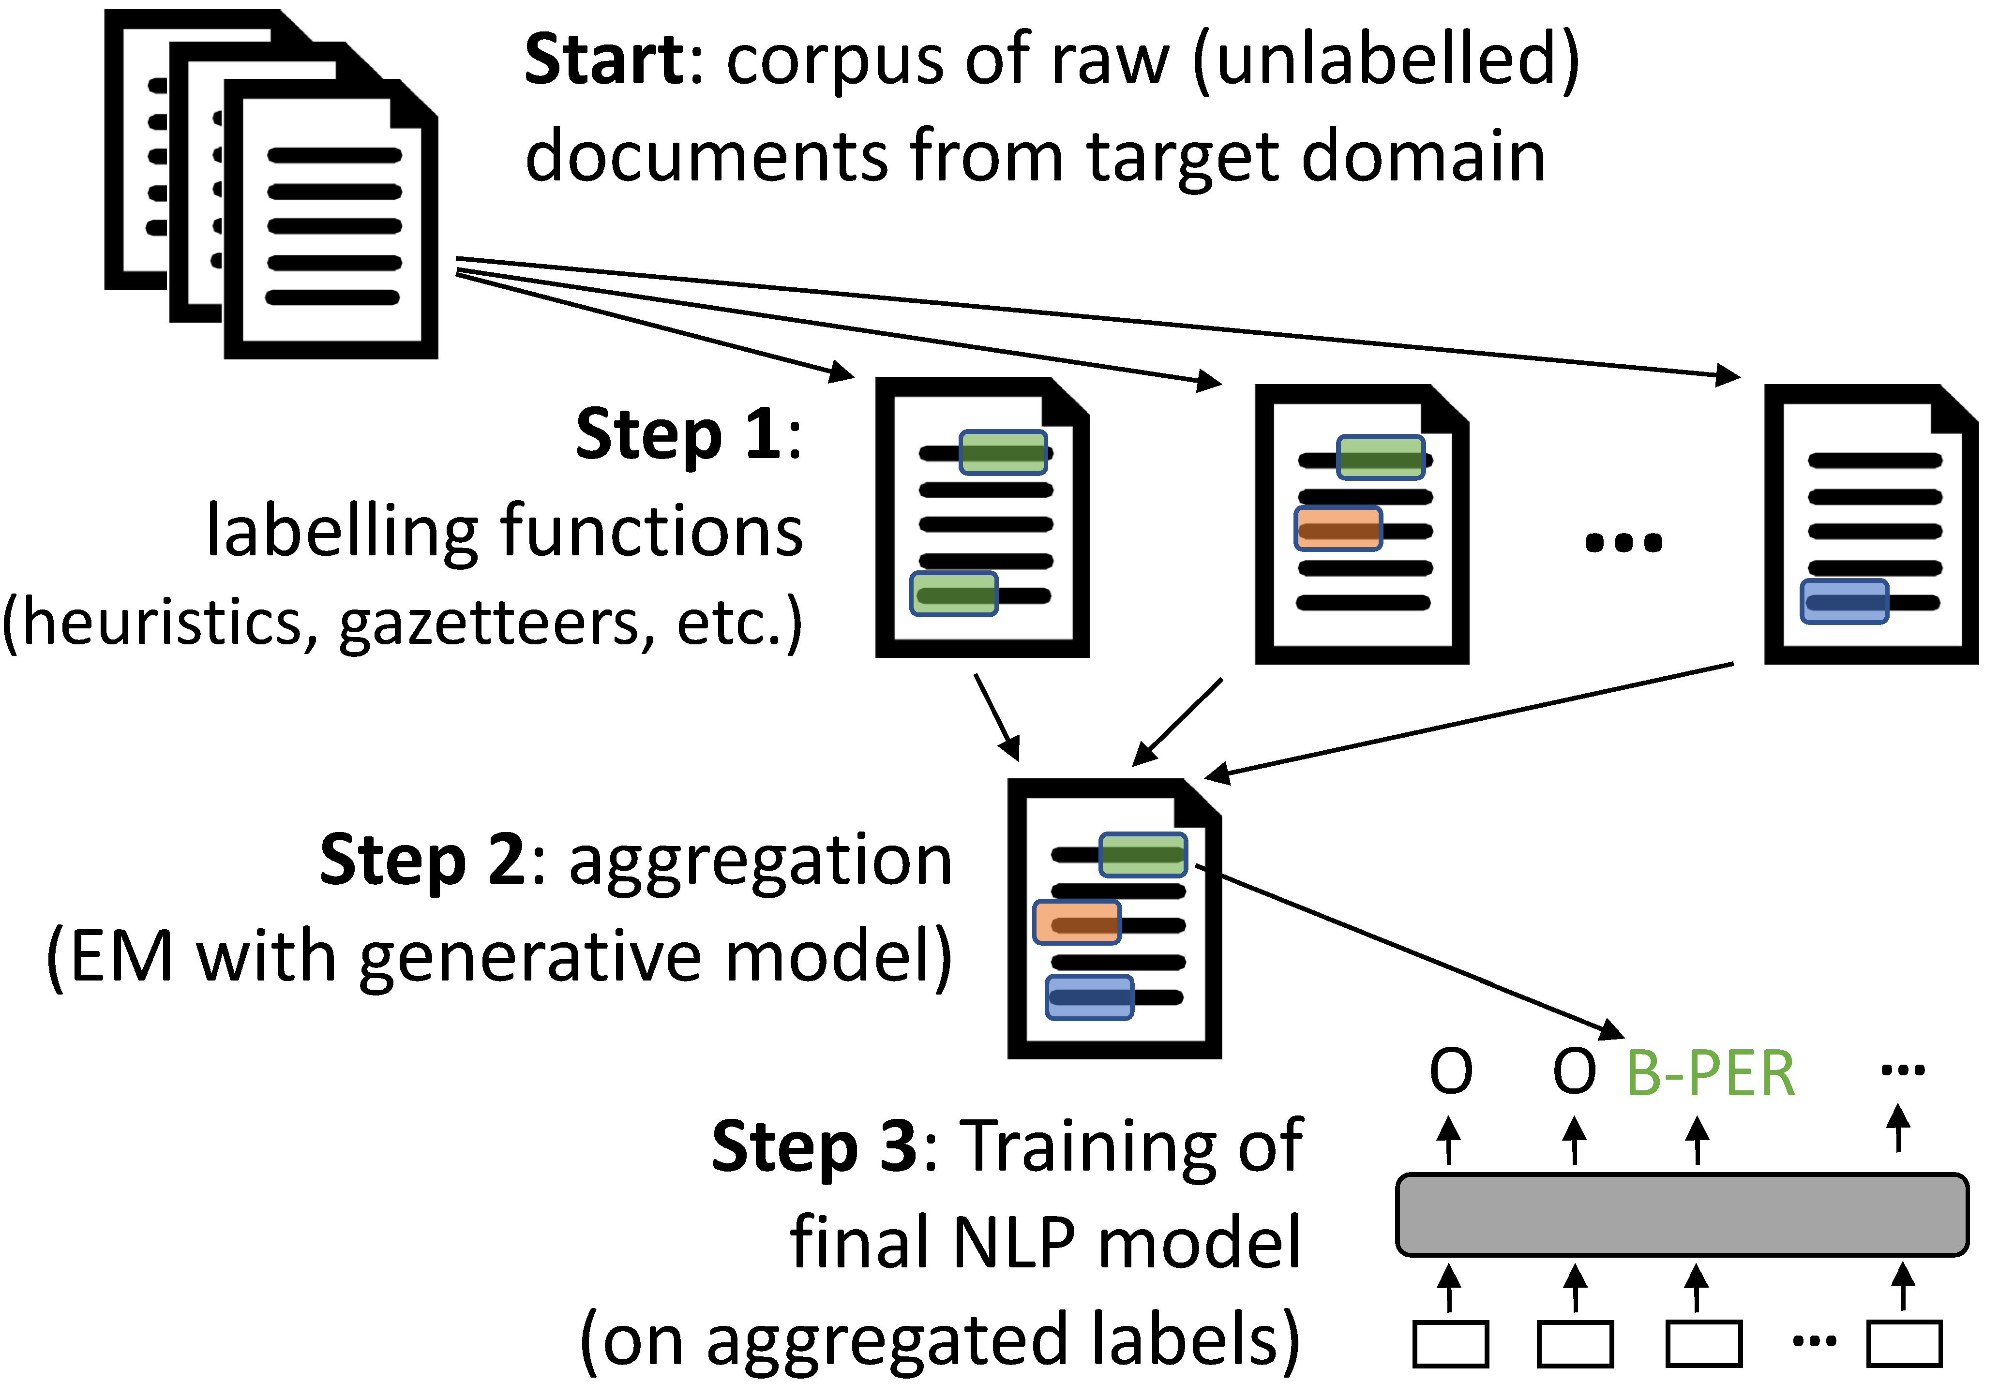
Illustration for sequence labelling

Slide 6
The skweak toolkit
A versatile Python toolkit to automatically annotate training data using labelling functions
The results of all labelling functions are aggregated using a generative model
Can be applied to any type of sequence labelling or classification task!

Slide 7
Labelling functions
Skweak comes along with a full-fledged, Python-based API to define & combine labelling functions for NLP tasks:
Heuristic rules
Gazetteers
ML models
Document-level constraints
Etc.

Slide 8
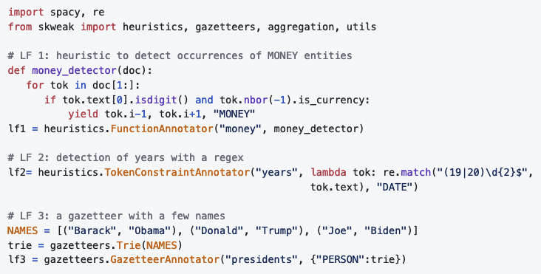
Very simple example

Slide 9
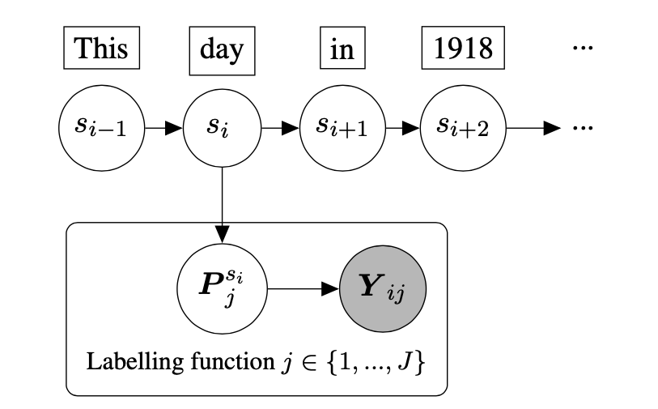
Aggregation model
Generative model where the states are the «true» labels and are associated with multiple observations (one per LF)
NB for text classification
HMM for sequence labelling

Slide 10
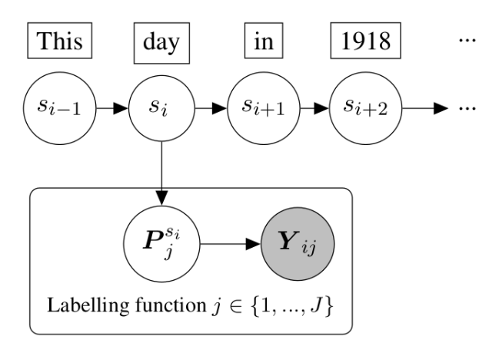
Aggregation model
Transition & emission models estimated with Baum-Welch (unsupervised!)
We add a constraint: for a given state s_{i}, the likelihood of a label can be > 0 only if at least one LF predicts that label

Slide 11
Extra functionalities
LFs can make use of underspecified labels such as ENT or NOT-PERSON
Each underspecified label is associated to a group of actual labels
A weighting scheme can also capture correlations between LFs
LFs that are strongly correlated with one another should have lower weights
Latest addition: multi-label classification!
Estimation of distinct generative models for each label
Posterior distributions are postprocessed to account for e.g. mutual exclusivity between labels

Slide 12
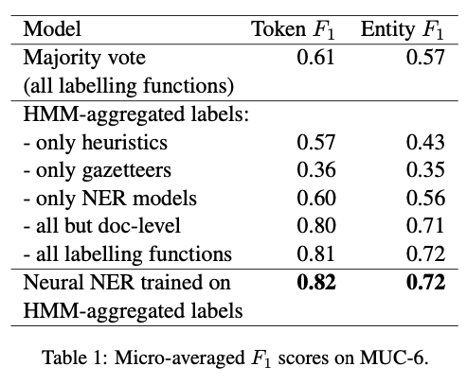
Some experimental results
NER on the MUC-6 corpus (7 entity types):
Results using 52 labelling functions:

Slide 13
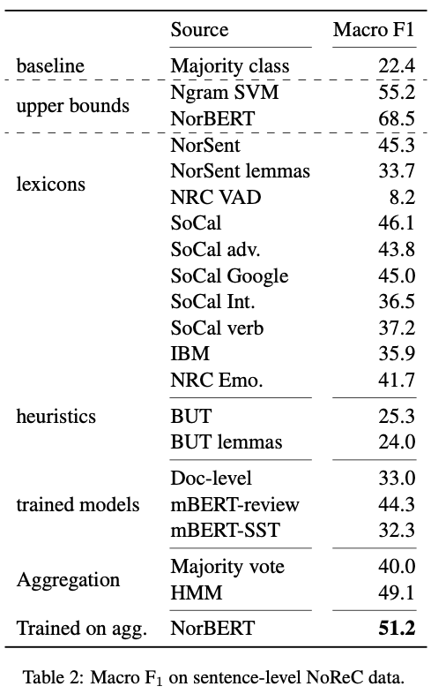
Some experimental results (2)
Sentiment analysis on the Norwegian Review Corpus data:

Slide 14
Conclusion
Weak supervision is a powerful approach to train machine learning models in the absence of labelled data
Allow us to inject expert knowledge (from heuristics, existing resources, etc.) into the model
Skweak provides an easy-to-use, yet powerful API to label training data for NLP tasks!

Slide 15
Conclusion
Interested? Test our toolkit at
https://github.com/NorskRegnesentral/skweak
We have several ideas for further extensions or improvements just waiting to be implemented
If you wish to contribute or collaborate with us, get in touch!

