Slide 1
www.nr.no
ggplot2
- spatial plotting
Norsk statistikermøte, Halden, 11. juni 2013
Elisabeth Orskaug
Thordis Thorarinsdottir
Norsk Regnesentral
André Teigland
Forskningssjef
SAMBA

Slide 2
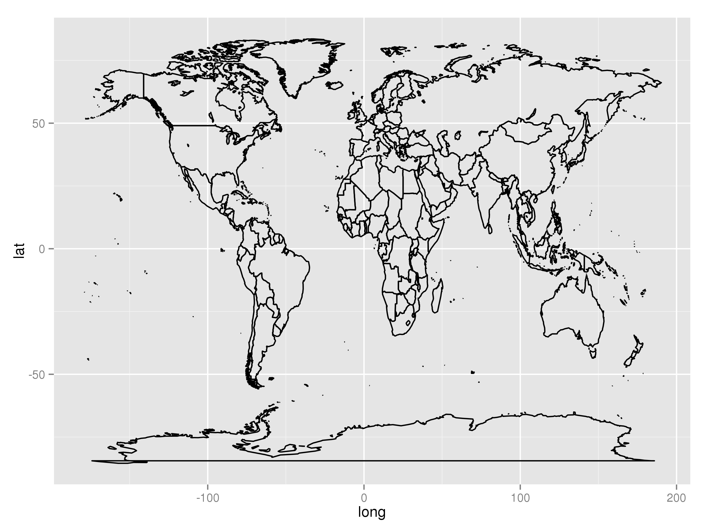
Spatial visualization with qplot()
4. ggplot2-spatial
Section 4.1
Using functions in R, one can plot basic geographic information, for instance a shape file containing polygons for areal data.
Areal data is data which corresponds to geographical extents with polygonal boundaries.

Slide 3
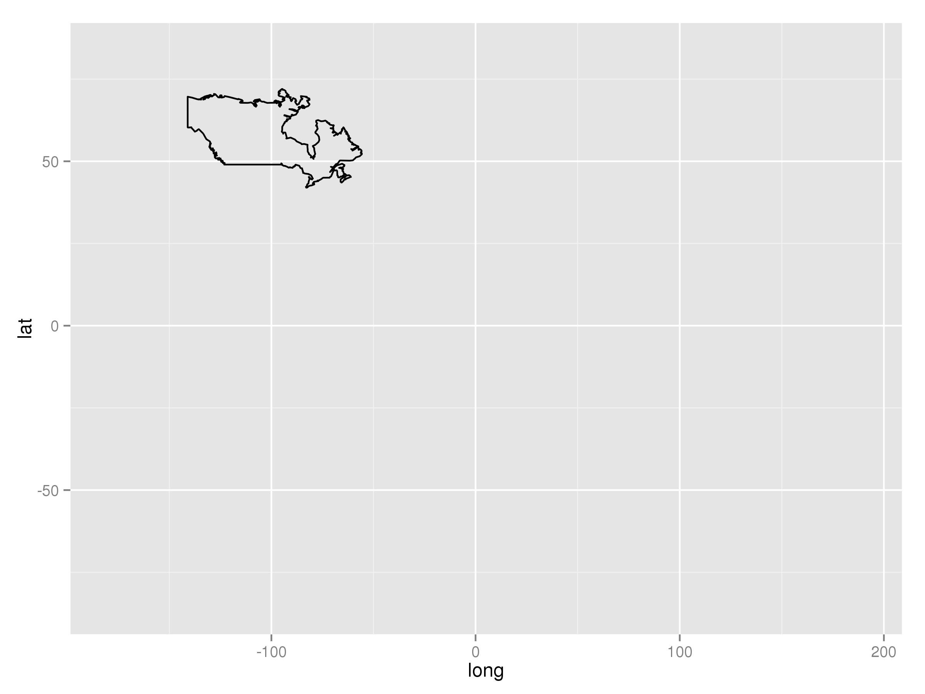
Spatial visualization with qplot()
4. ggplot2-spatial
Section 4.2
Taking out one area from world map
ind = which(world[,3]==1)
qplot(long,lat,data=world[ind,],geom="path", group=group) + xlim(range(world[,1])) + ylim(range(world[,2]))
Example: world data set
long lat group order region subregion
1 -133.3664 58.42416 1 1 Canada <NA>
2 -132.2681 57.16308 1 2 Canada <NA>
3 -132.0498 56.98610 1 3 Canada <NA>
4 -131.8797 56.74001 1 4 Canada <NA>
5 -130.2492 56.09945 1 5 Canada <NA>
6 -130.0131 55.91169 1 6 Canada <NA>

Slide 4
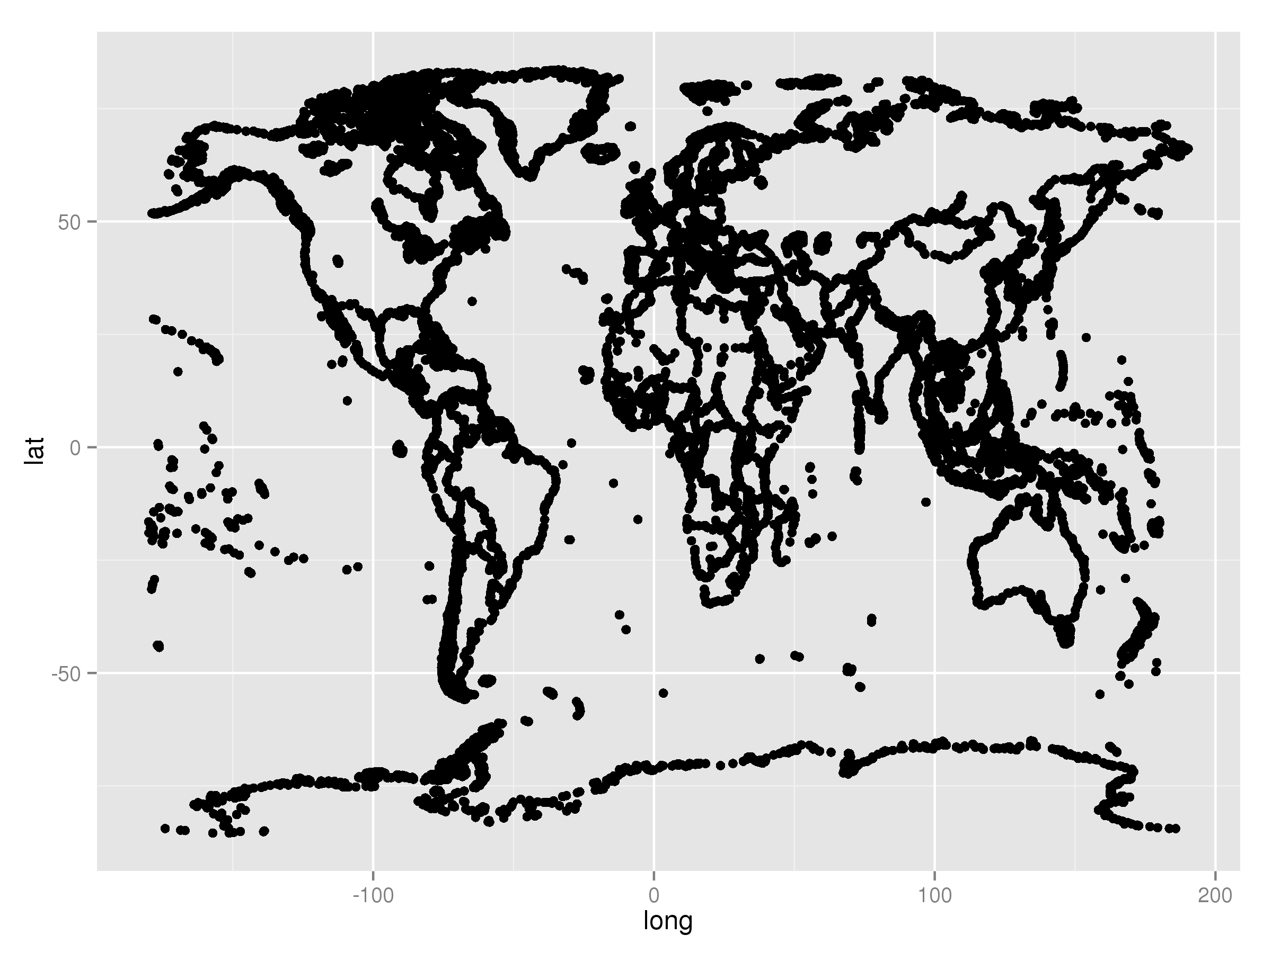
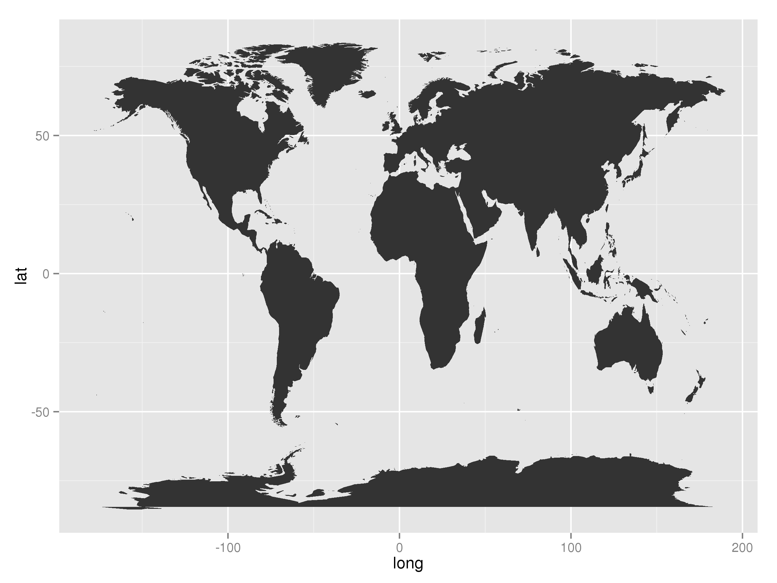
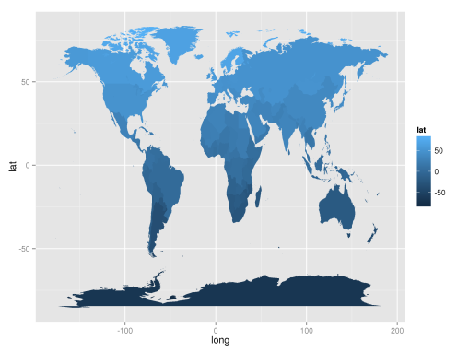
Spatial visualization with qplot()
4. ggplot2-spatial
Section 4.3
Plot map with function qplot()
qplot(long,lat,data=world,geom="point",group=group)
geom="point"
geom="path"
geom="polygon"
geom="polygon", fill=lat

Slide 5
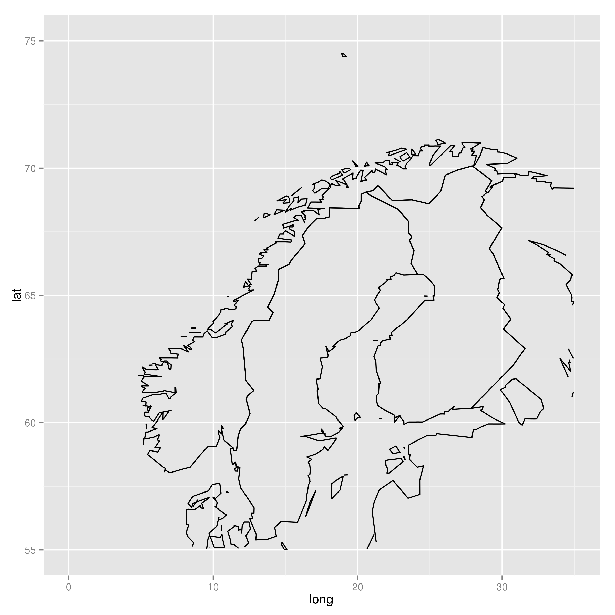
Spatial visualization with qplot()
4. ggplot2-spatial
Section 4.4
Zoom in on locations in the map:
qplot(long, lat, data=world, geom="path", group = group) + xlim(c(0,35)) + ylim(c(50,75))

Slide 6
Assignment
4. ggplot2-spatial
Section 4.5
Make a map that zooms in on Afrika, and fill the area with red color. The longer north, the darker color. (You can try to change the fill color also for instance to red. Hint: ?scale_fill_gradient )

Slide 7
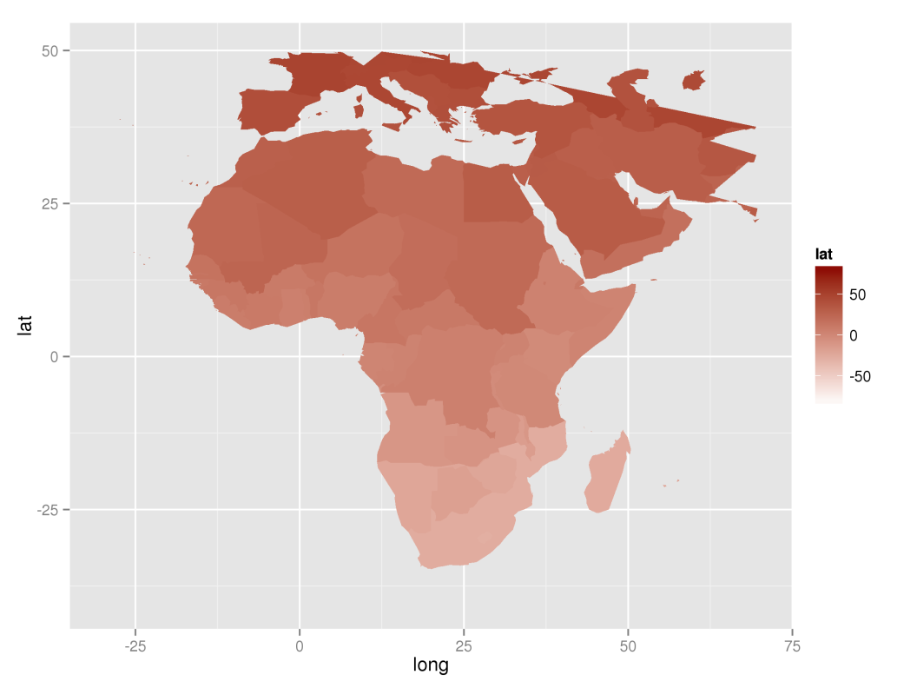
Suggestion
4. ggplot2-spatial
qplot(long, lat, data=world, geom="polygon", group = group,fill=lat) + xlim(c(-30,70)) + ylim(c(-40,50)) + scale_fill_gradient(low = "white", high = "dark red")

Slide 8
Spatial visualization with ggplot()
4. ggplot2-spatial
Section 4.6
Plotting map:
map = geom_path(aes(x=long, y=lat, group = group), data=world)
ggplot() + map

Slide 9
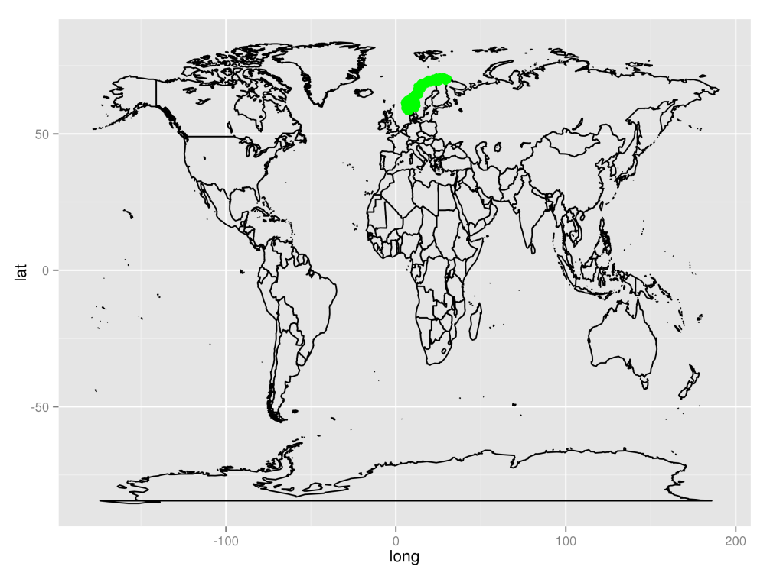
Spatial visualization with ggplot()
4. ggplot2-spatial
Section 4.7
Plotting points on a map:
ggplot() + map + geom_point(aes(x=lon,y=lat),colour="green", data=norwayGrid)

Slide 10
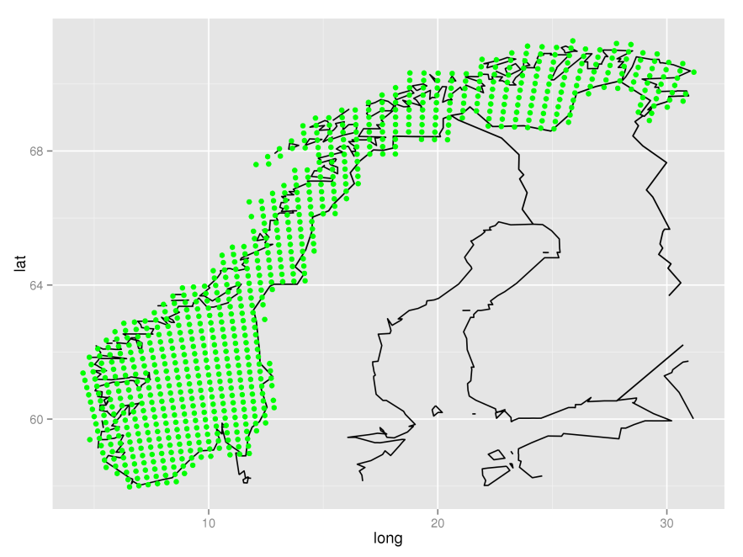
Spatial visualization with ggplot()
4. ggplot2-spatial
Zoom in on locations in the map:
ggplot() + map + geom_point(aes(x=lon,y=lat),colour="green", data=norwayGrid) + xlim(range(norwayGrid$lon)) + ylim(range(norwayGrid$lat))
map = list(geom_path(aes(x=long, y=lat, group = group), colour="grey50", data=world), scale_x_continuous(limits=range(norwayGrid$lon)), scale_y_continuous(limits = range(norwayGrid$lat)) )
Section 4.8

Slide 11
Assignment
4. ggplot2-spatial
Section 4.9
Zoom in on Australia with ggplot() using data from data set world. Hint: use region=="Australia"

Slide 12
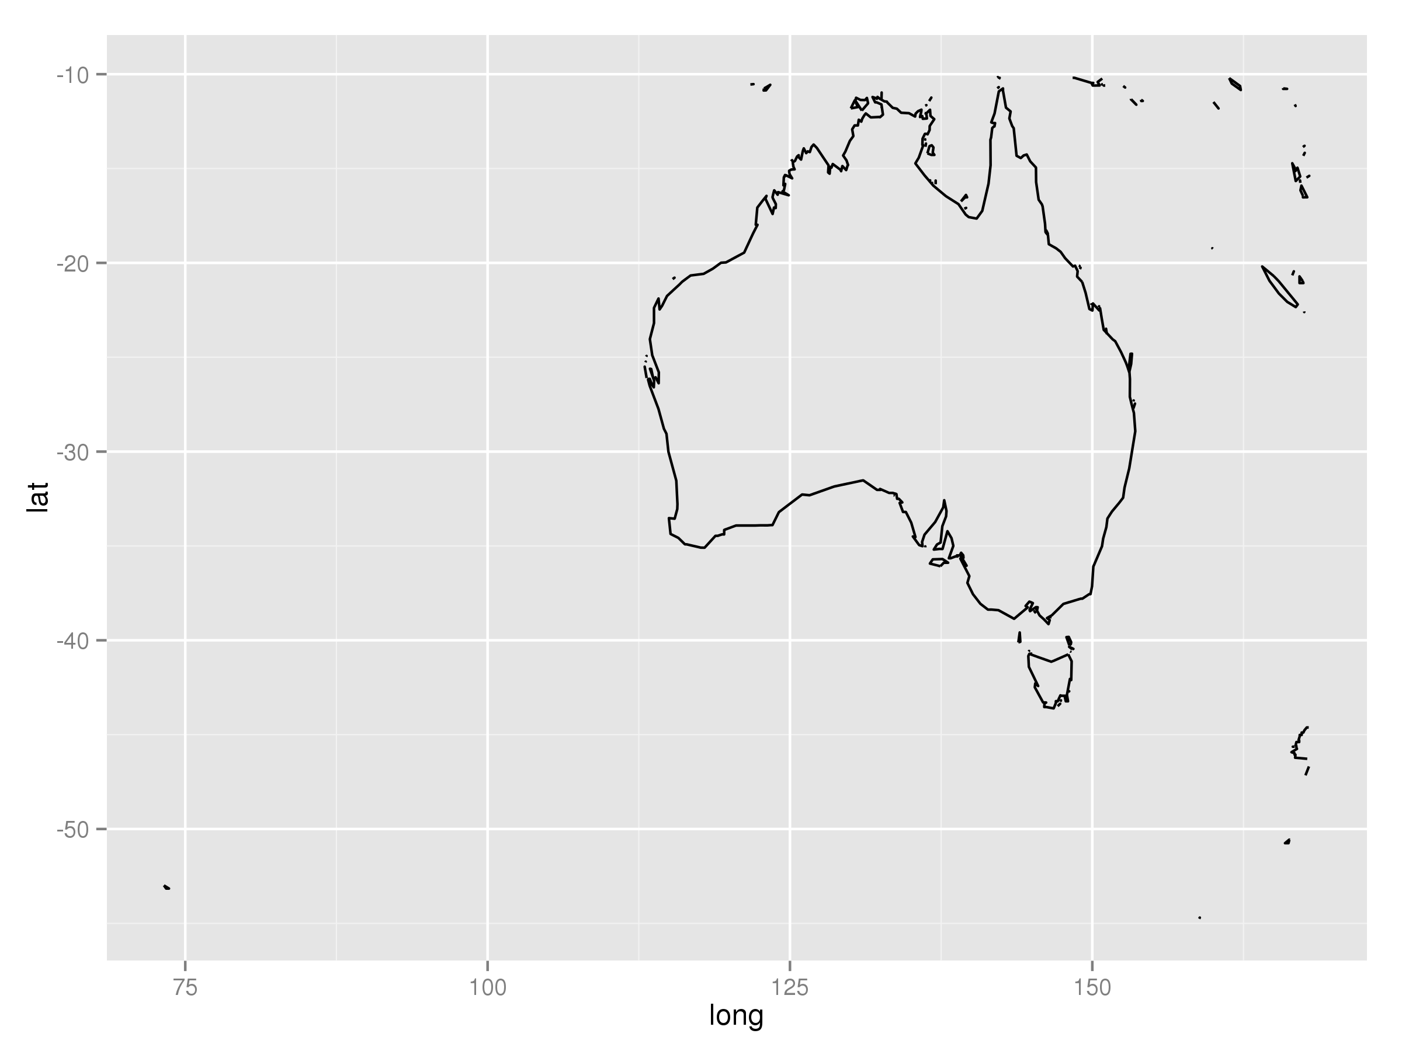
Suggestion
4. ggplot2-spatial
ind = which(world$region=="Australia")
ggplot() + map + xlim(range(world[ind,1])) + ylim(range(world[ind,2]))

Slide 13
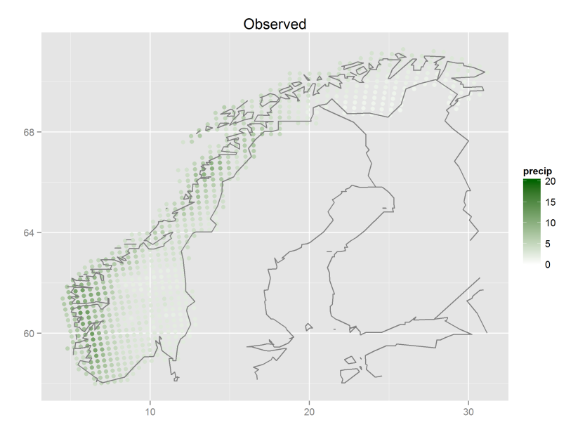
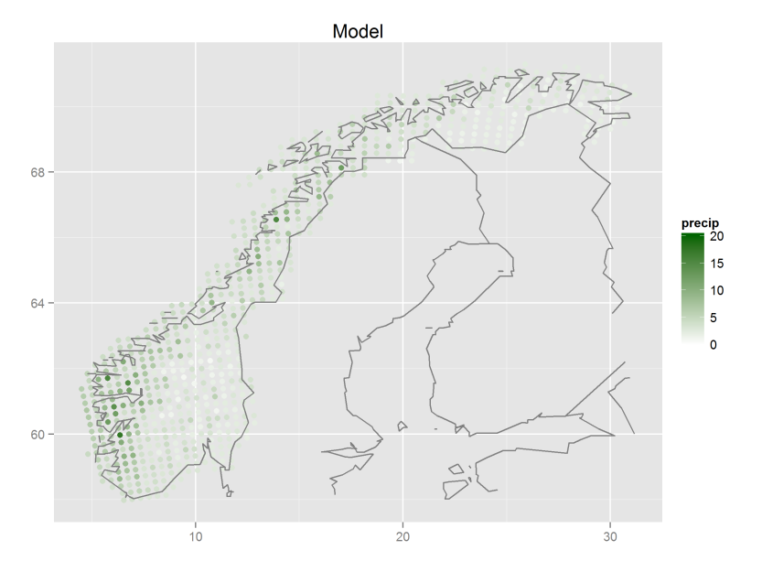
Spatial map with time series
4. ggplot2-spatial
Section 4.10
Plotting precipitation over the norwegian mainland, both model and observations:
1) qplot(lon, lat, data=all.stats, colour=obs.mean, geom="point", xlab="", ylab="", main="Observed") + scale_colour_gradient(name="precip", limits=c(0,20), low="white", high="green") + map
2) qplot(lon, lat, data=all.stats, colour=mod.mean, geom="point", xlab="", ylab="", main="Model") + scale_colour_gradient(name="precip", limits=c(0,20), low="white", high="green") + map

Slide 14
Assignment
4. ggplot2-spatial
Section 4.11
Make a spatial map of the difference in precipitation in 3.-quartile (Q3) for observed data and model data. Choose blue color scale.

Slide 15
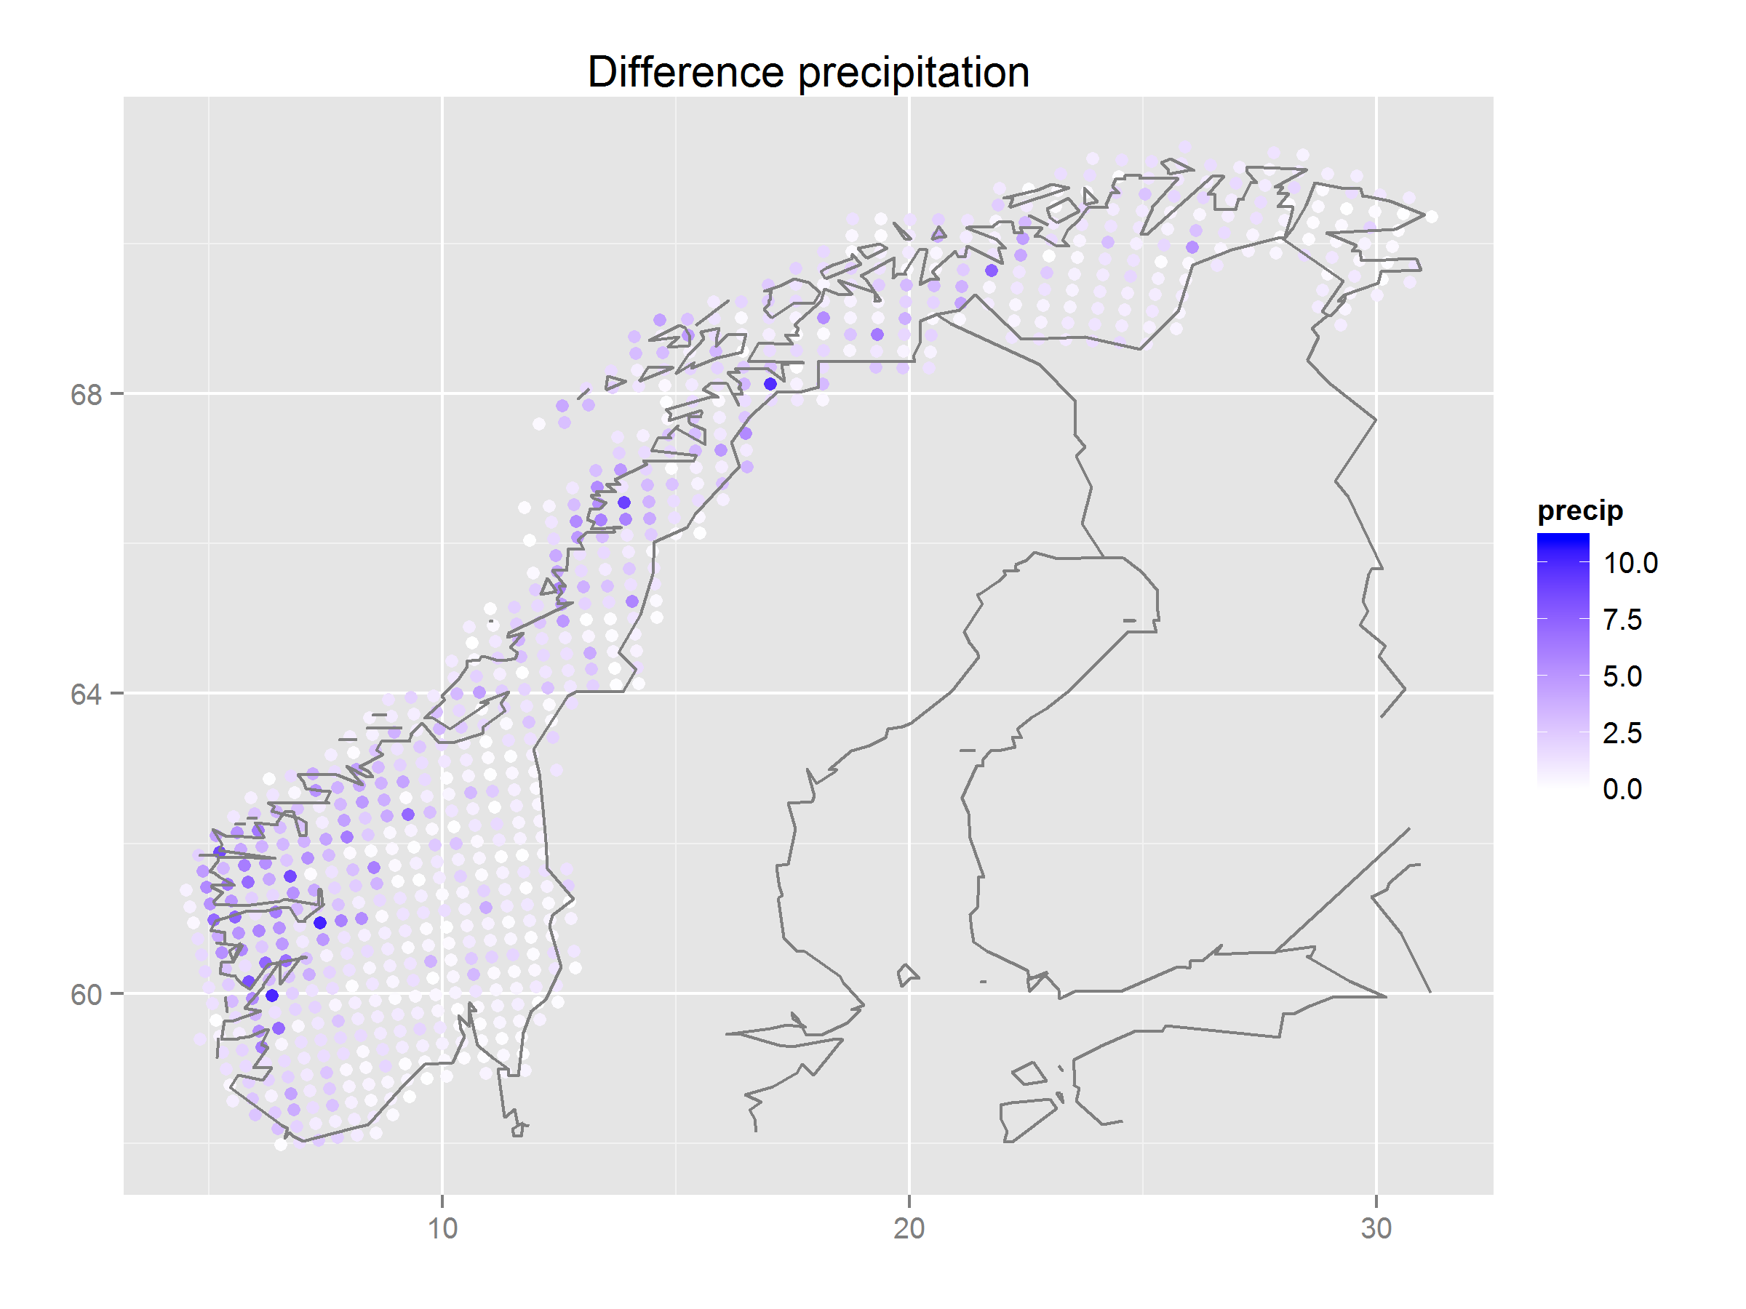
Suggestion
4. ggplot2-spatial
qplot(lon, lat, data=all.stats, colour=abs(obs.Q3-mod.Q3), geom="point", xlab="", ylab="", main="Difference precipitation") + scale_colour_gradient(name="precip", limits=c(0,11), low="white", high="blue") + map

Slide 16
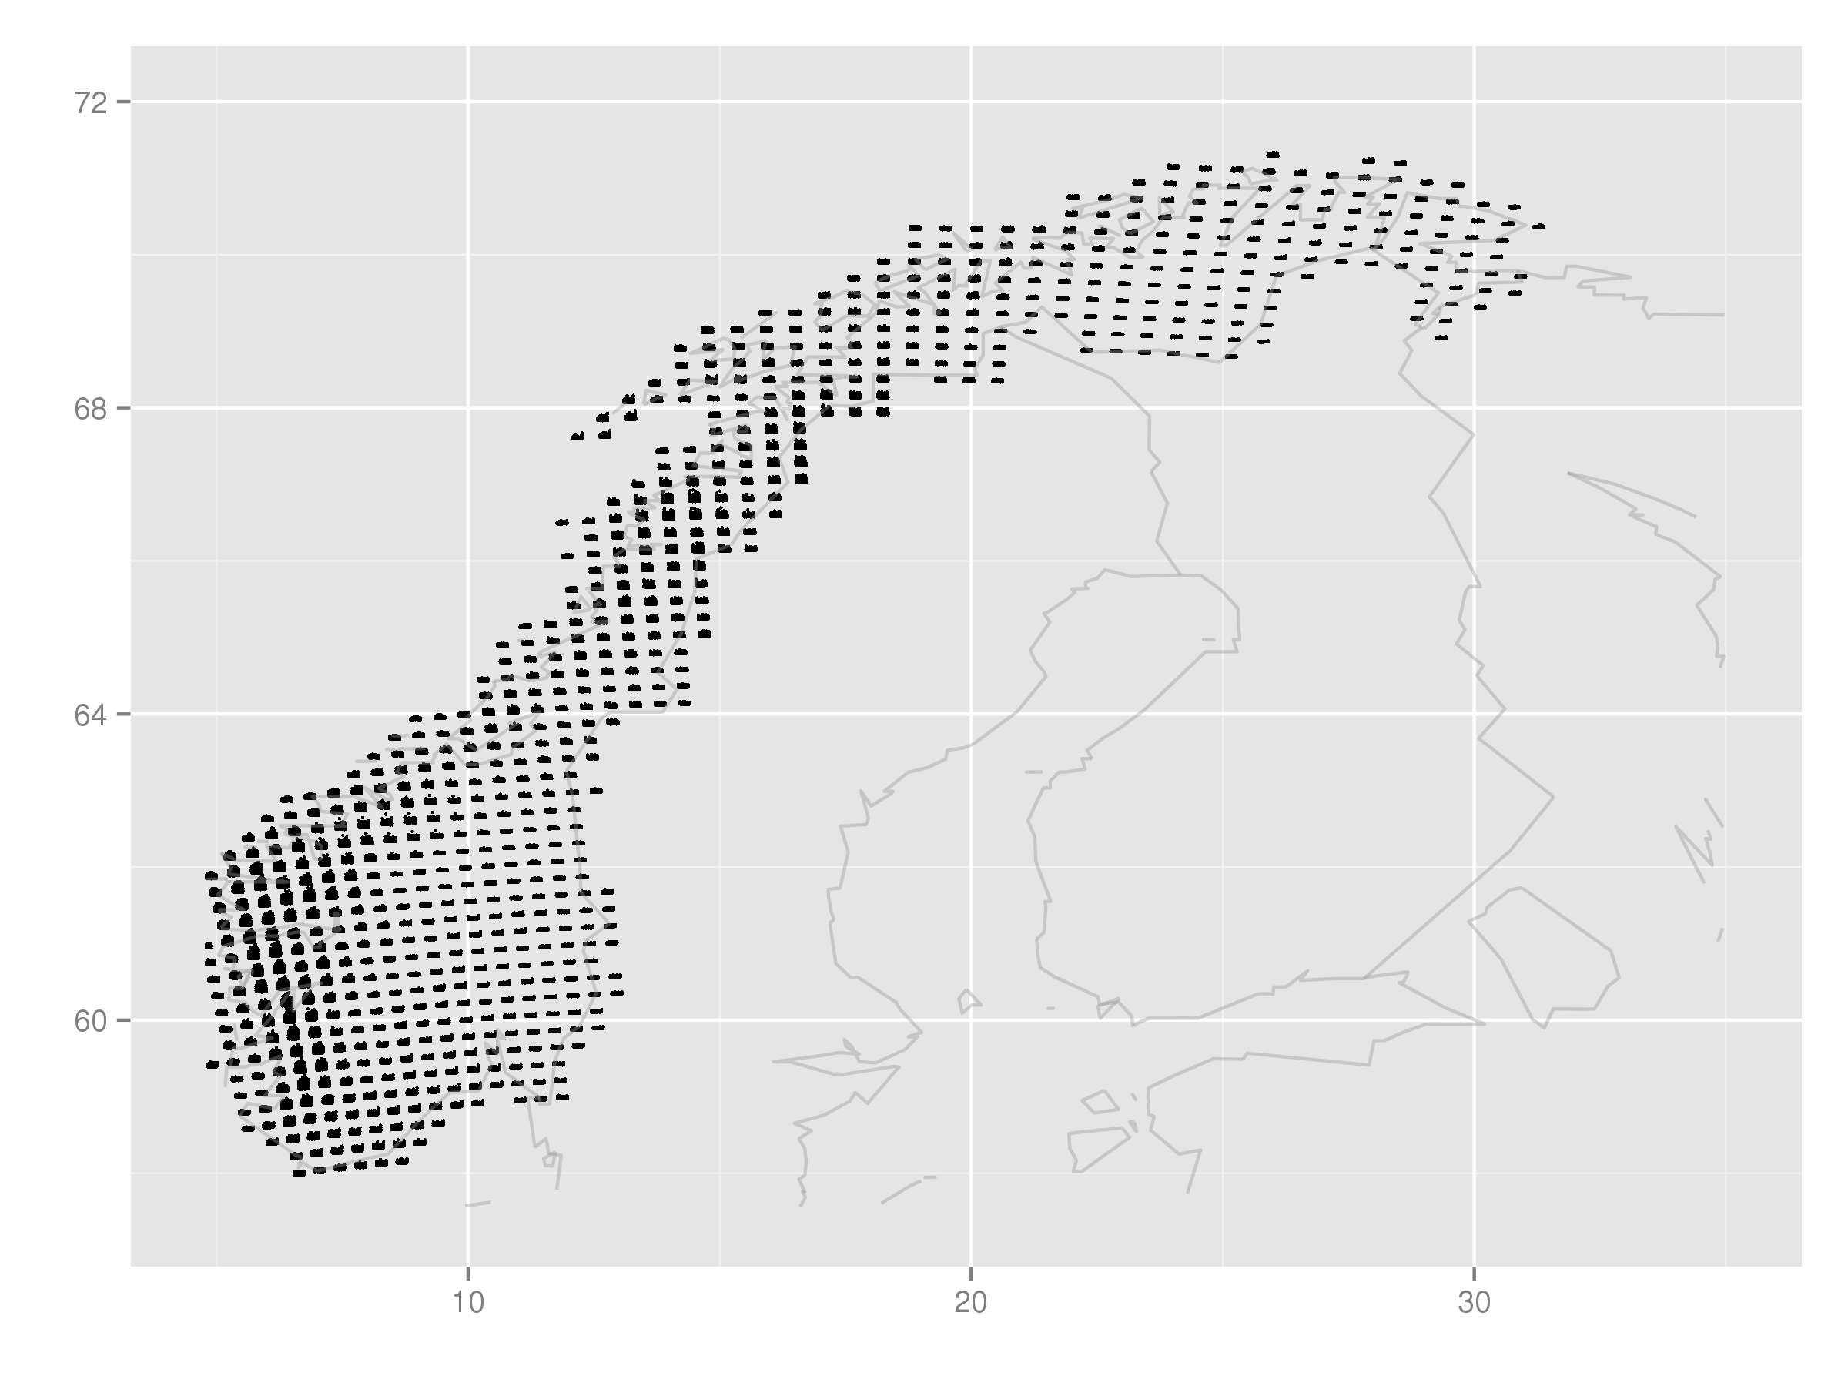
Spatial map with time series
4. ggplot2-spatial
Section 4.12
Observations with time series in each grid point:
qplot(lon+time_r/5, lat+OBS_r/5, data=data.grid.mth.agg, xlab="", ylab="", group=interaction(lon, lat), size=I(0.5), xlim=c(4.8, 35), ylim=c(57.5, 72)) + map

Slide 17
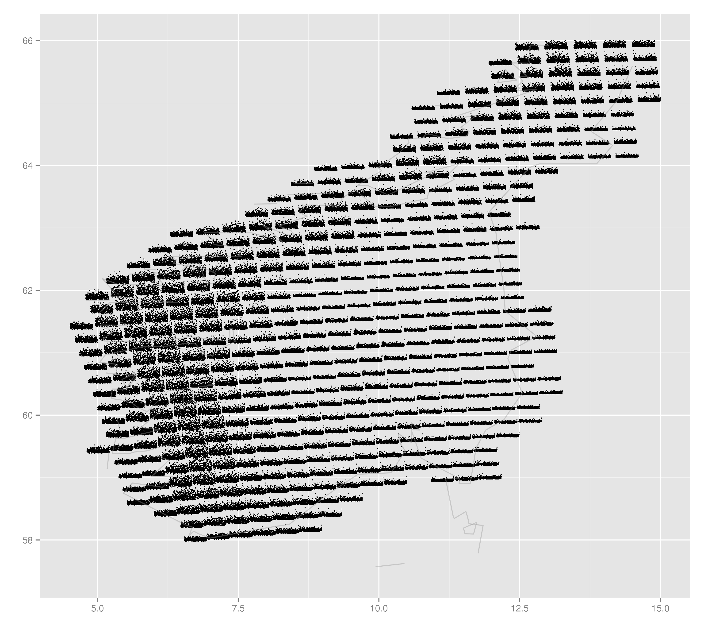
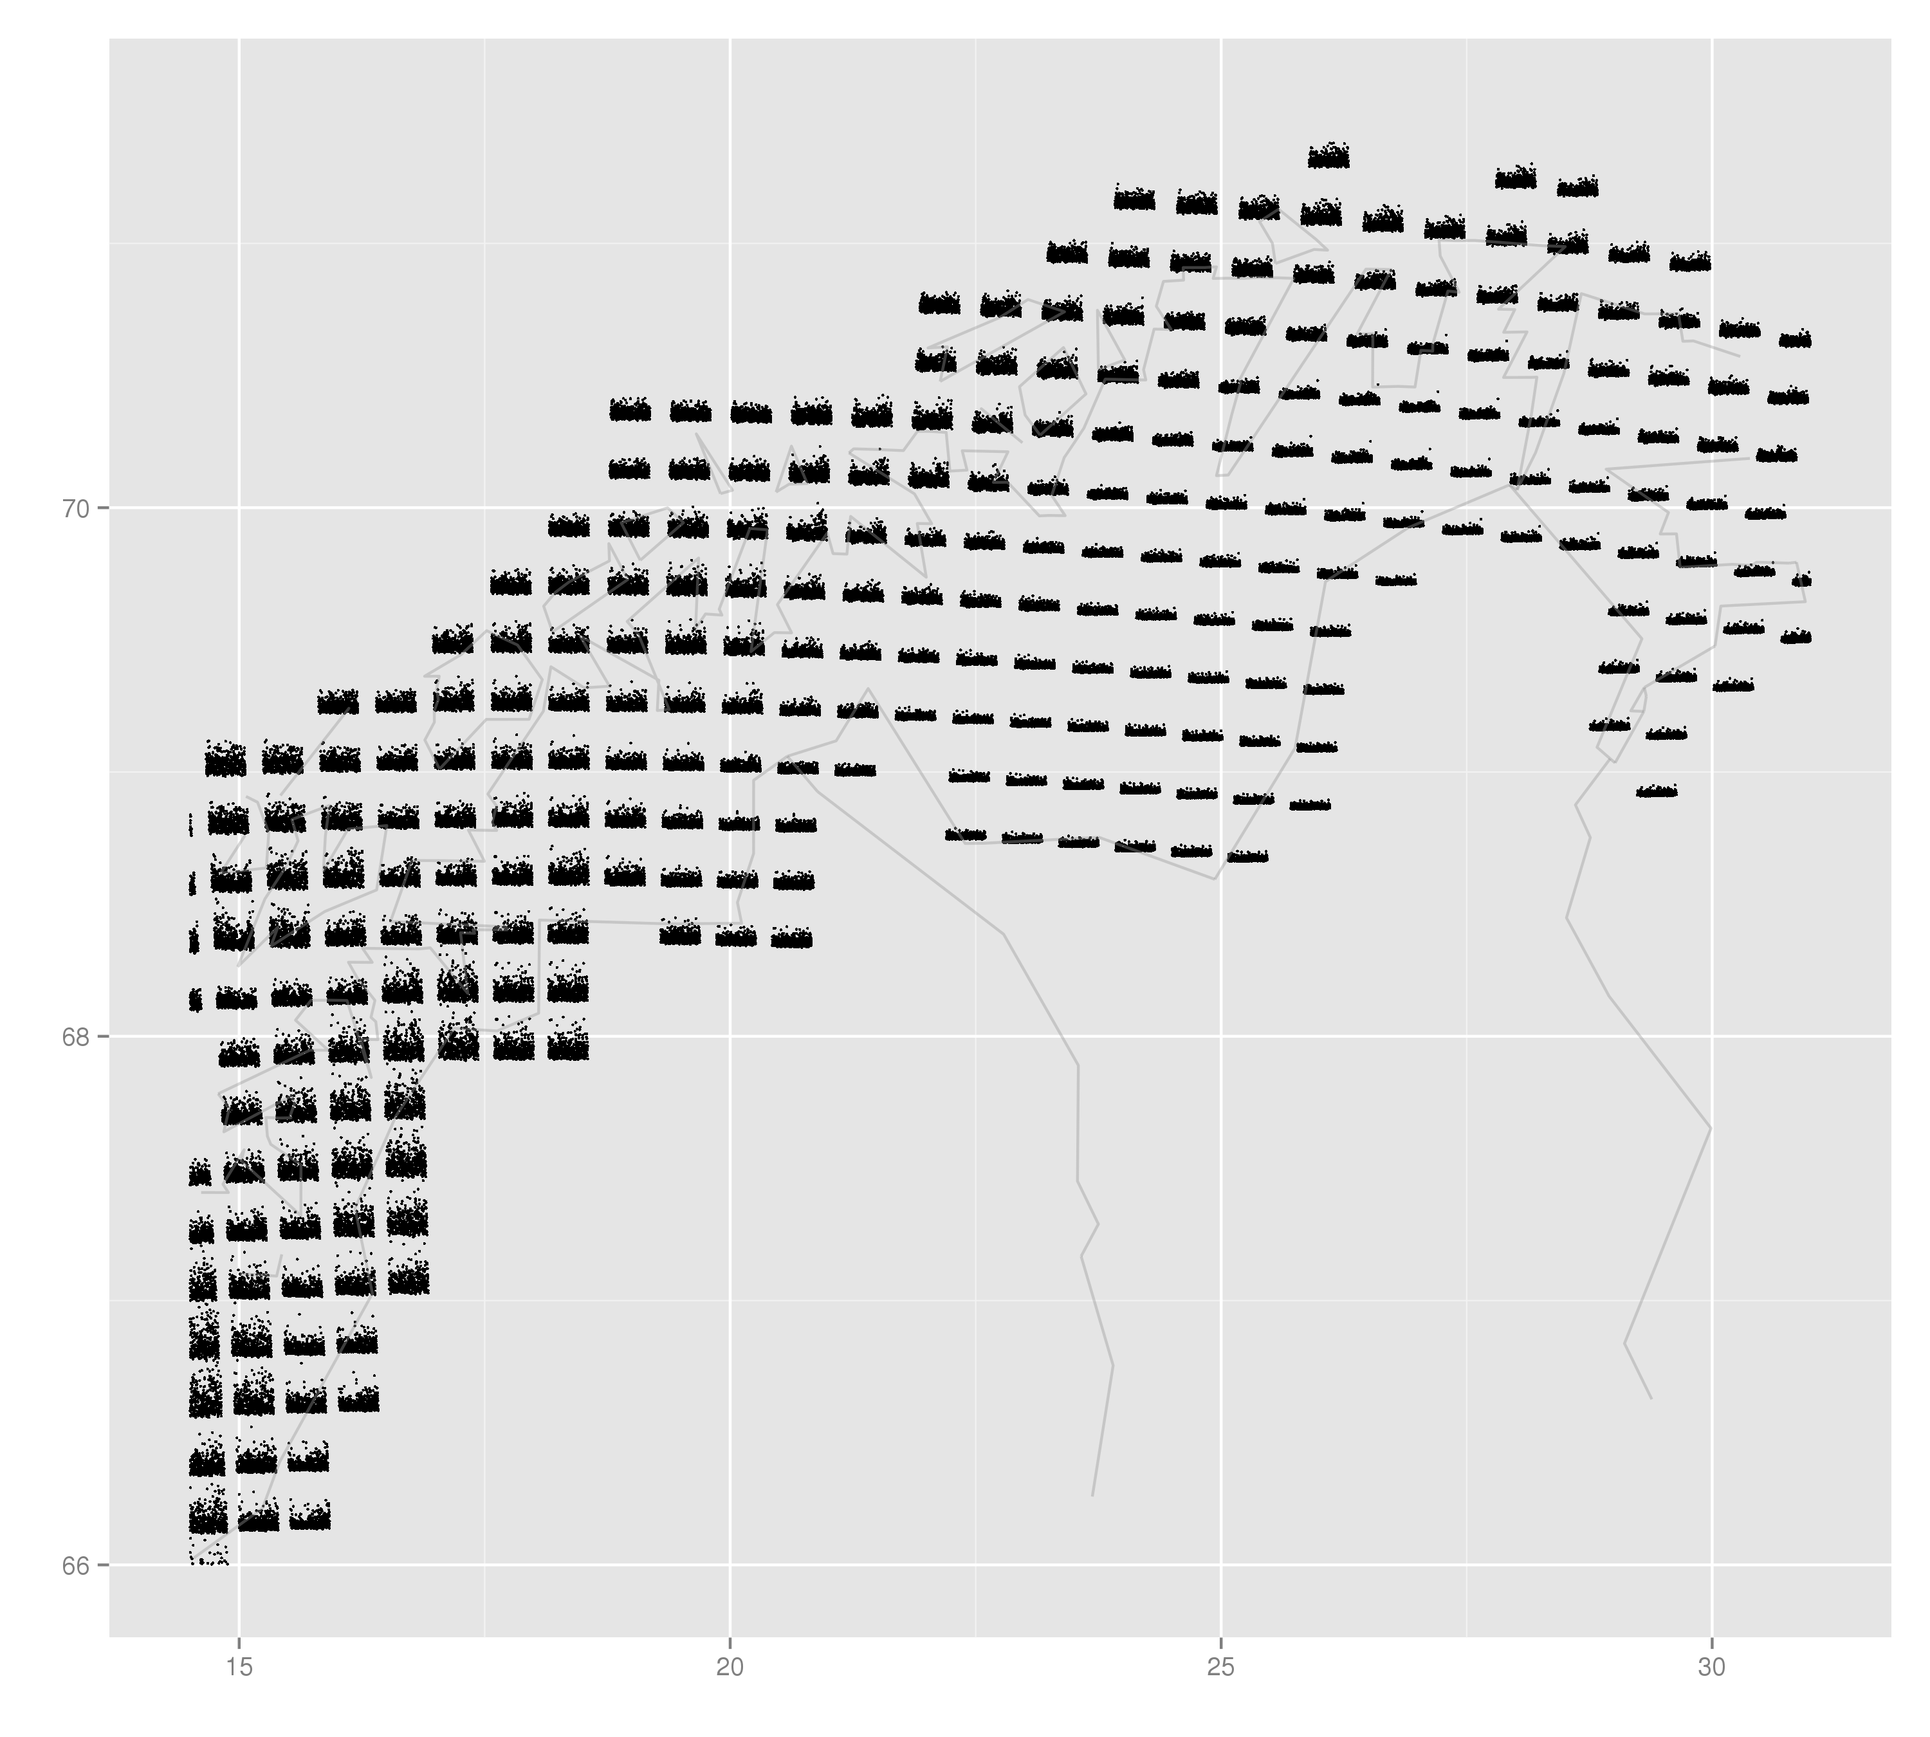
Spatial map with time series
4. ggplot2-spatial
Split Norway in two:
Adjust xlim and ylim.
Section 4.13

Slide 18
Assignment
4. ggplot2-spatial
Section 4.14
Make a spatial map with seasonal time series of the observations, and split the map in two. Hint: use month_r

Slide 19
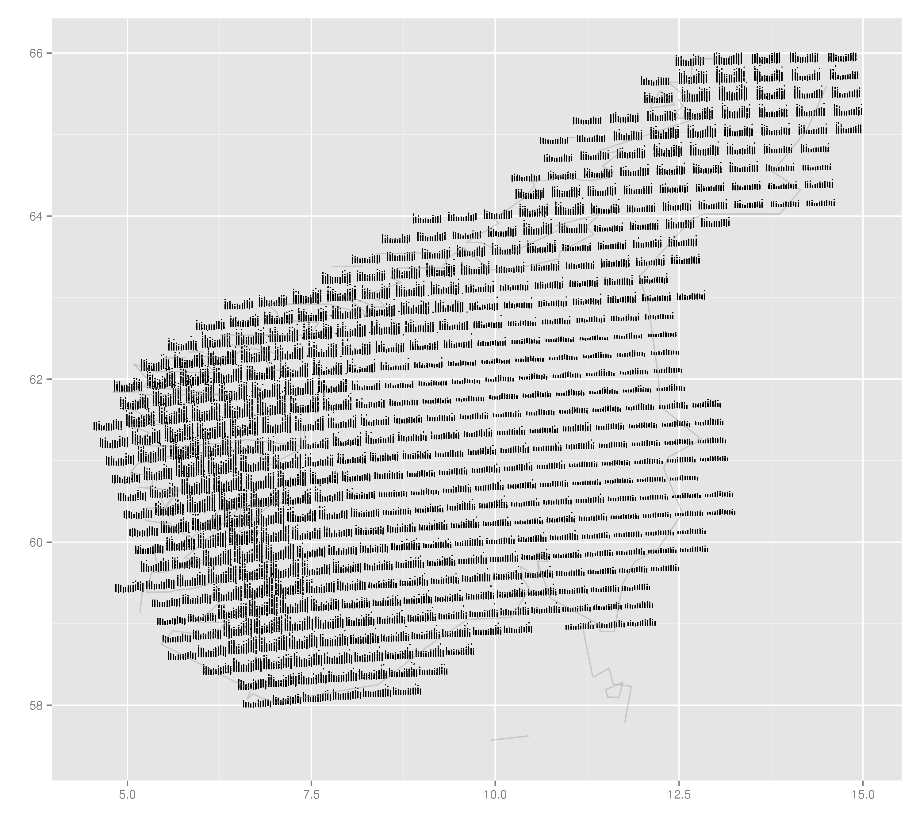
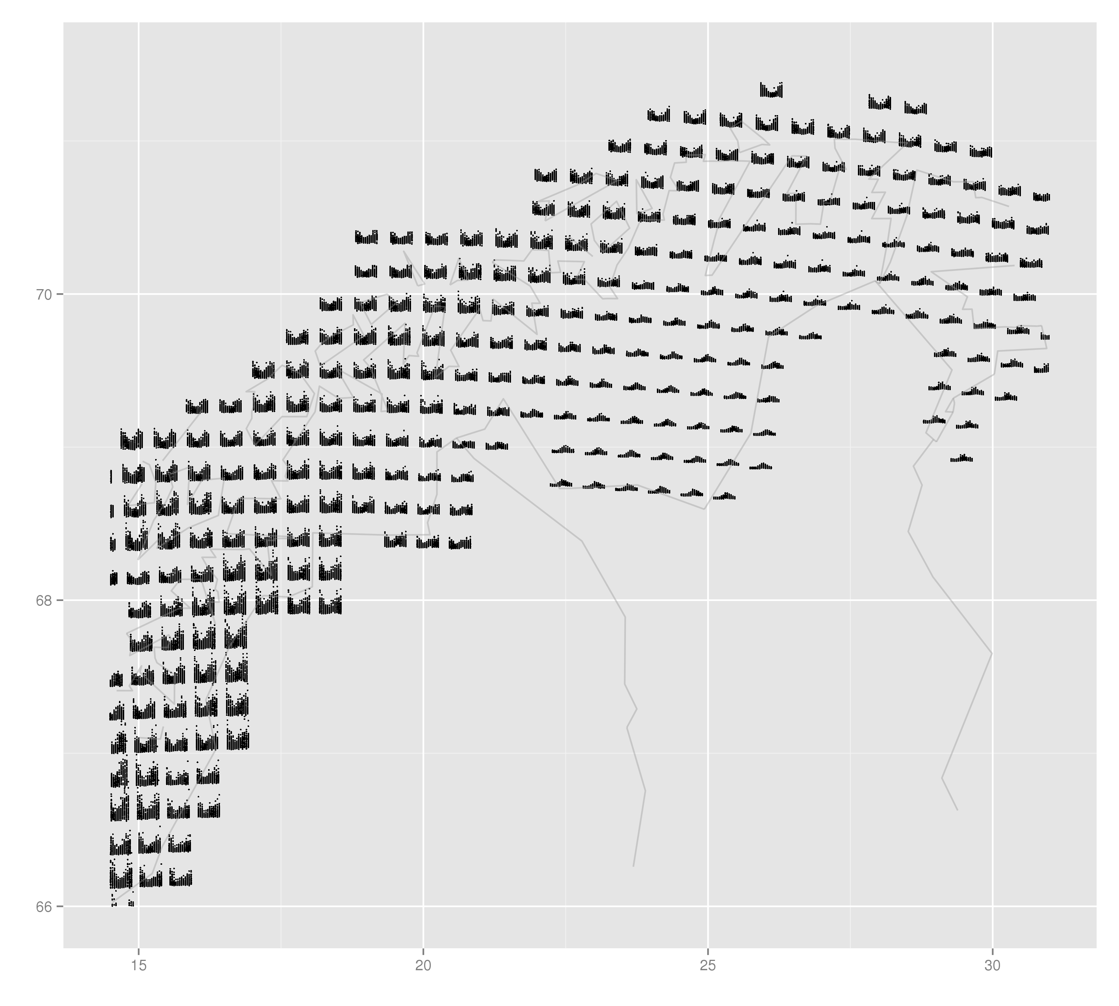
Suggestion
4. ggplot2-spatial
1) qplot(lon+month_r/2.5, lat+OBS_r/2.5, data=data.grid.mth.agg, xlab="", ylab="", group=interaction(lon, lat), size=I(0.5), xlim=c(4.5, 15), ylim=c(57.5, 66)) + map
2) qplot(lon+month_r/2.5, lat+OBS_r/2.5, data=data.grid.mth.agg, xlab="", ylab="", group=interaction(lon, lat), size=I(0.5), xlim=c(14.5, 31), ylim=c(66, 71.5)) + map

Slide 20
www.nr.no
Coffee break
André Teigland
Forskningssjef
SAMBA

