Slide 1
www.nr.no
Animation
Norsk statistikermøte, Halden, 11. juni 2013
Elisabeth Orskaug
Thordis Thorarinsdottir
Norsk Regnesentral
André Teigland
Forskningssjef
SAMBA

Slide 2
Animation
6. Animation
The package "Animations" contains a variety of functions for animations in statistics.
Several approaches to save animations to various formats, e.g. Flash, GIF, HTML pages, PDF and videos.
Only animations in HTML will be shown. For details on other formats, see animation.pdf.

Slide 3
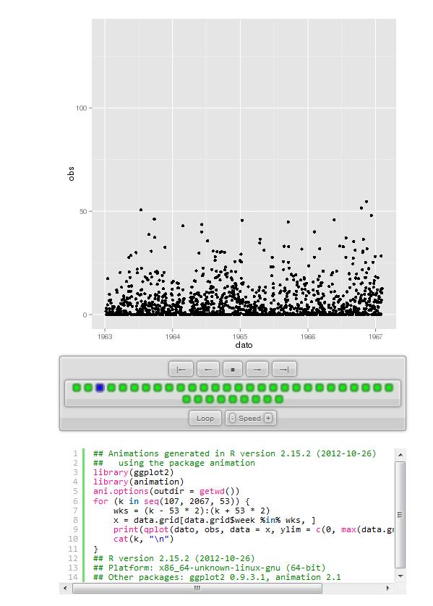
Animation of time series
6. Animation
Animation of daily observed precipitation from 1961-2000.
# Begin animation loop
#Animation in HTML pages. Note the brackets within the parentheses.
saveHTML({
#set some animation options
ani.options(outdir = getwd())
# Begin the loop that creates the individual animation graphs
for (k in seq(107, 2067, 53)){
wks = (k-53*2):(k+53*2)
x = data.grid[data.grid$week %in% wks,]
print(qplot(dato, obs, data=x, ylim=c(0,max(data.grid$obs))))
cat(k, "\n")
}
#Save the animation graphs
}, img.name = "plotAniPrec", imgdir="animationPrec-temp", outdir=getwd(), htmlfile="animationPrec-temp.html", autobrowse = FALSE, title="")
Section 6.1

Slide 4
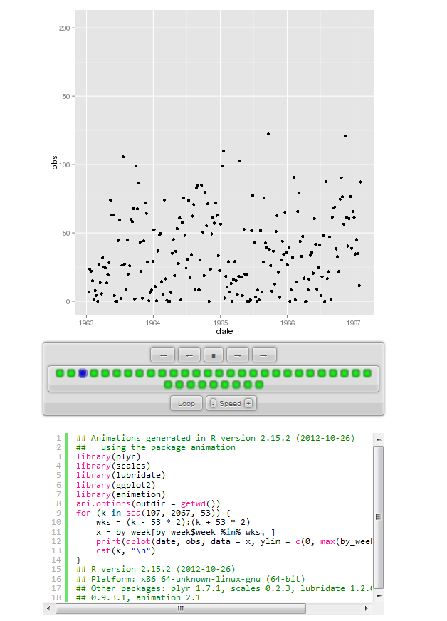
Animation of time series
6. Animation
Animation of weekly observed precipitation from 1961-2000.
We use ddply() function from ggplot2 to aggregate daily precipiation to weekly precipitation.
Then make an animation of the aggregated data.
Section 6.2

Slide 5
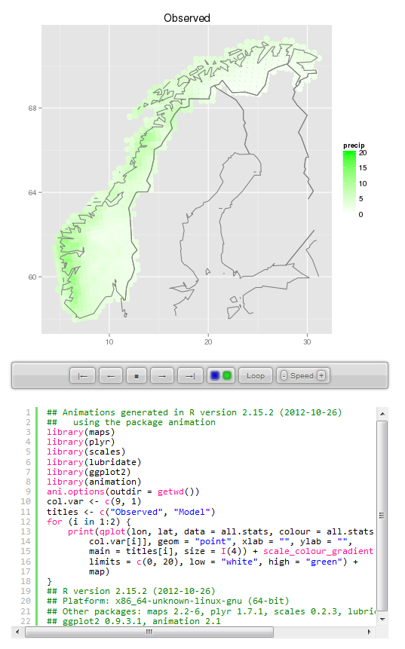
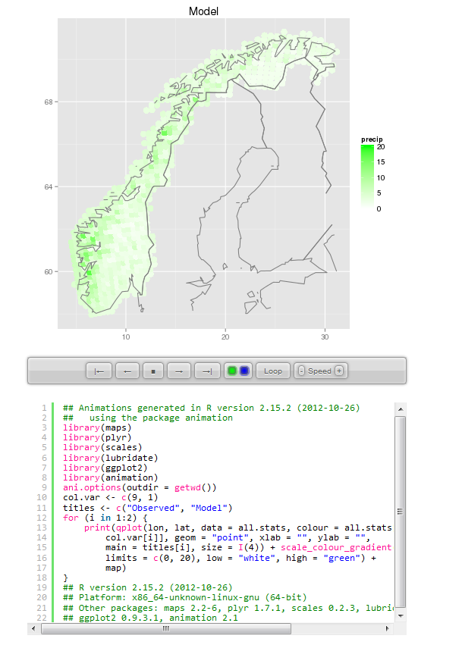
Animation of spatial map
6. Animation
Section 6.3

Slide 6
www.nr.no
Thank you for coming!
Lunch!
André Teigland
Forskningssjef
SAMBA

